Slide 1
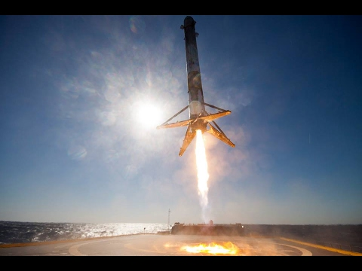
CONTRACTUAL MANAGEMENT OF THE GRANT
Brussels, January 2018

Slide 2

Why you are here ????
Approach and rules for sound contractual management:
  Essential information on the E+ Capacity Building in Higher Education Grant Agreement and other important documents

Slide 3
Presentation Content
Structure of the Grant Agreement (GA)
2. Implement your project in line with GA
        Amendments
        Monitoring and reporting

Slide 4

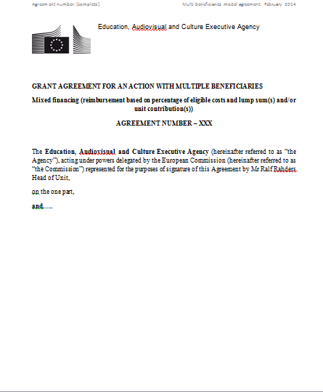
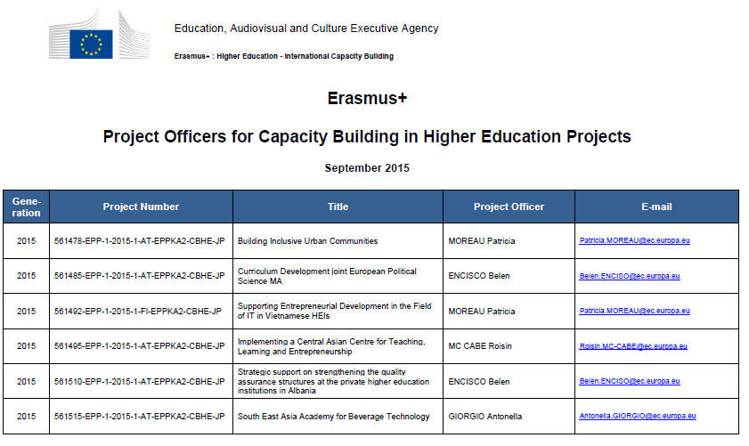
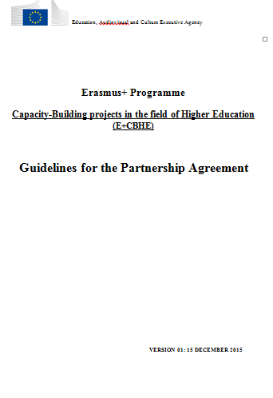
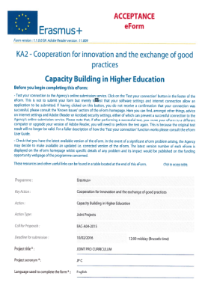

Contractual Documents
Multi-Beneficiary Grant Agreement signed by the coordinating HEI on behalf of the partnership
Shared obligation of the partnership!
Support documents and
guidelines for projects implementation available in the CBHE "Beneficiaries' Space"

Slide 5

Guidelines for the Use of the Grant
Valuable reference document
Cover a multitude of questions and different situations
Available on the E+ CBHE Website
  https://eacea.ec.europa.eu/erasmus-plus/beneficiaries-space/capacity-building-in-higher-education_en
Check regularly updated versions!

Slide 6
Structure of Grant Agreement (GA)
I. Special Conditions
II. Annexes
Annex I Description of the action >>>> YOUR APPLICATION
Annex II General Conditions
      Part A: Legal and Administrative Provisions
      Part B: Financial Provisions
Annex III Estimated budget of the action
Annex IV List of beneficiaries and Mandates
Annex V Model Technical Implementation report(s)
Annex VI Model financial statement(s)
Annex VII Report of Factual Findings on the
Final Financial Report
E-reporting

Slide 7




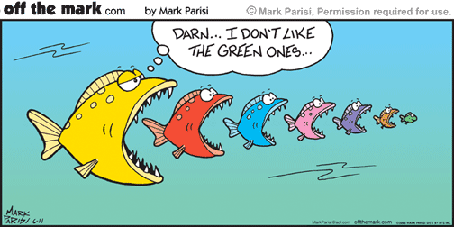
CALL FOR PROPOSALS
Grant Agreement: SPECIAL CONDITIONS
Annexes
General Conditions, Budget
Reports
_
Project Proposal

Slide 8


Slide 9
  Main characteristic of my project
Art. I.1
describes the purpose of the grant, the title of your project
Art. I.2
entry into force date, duration of the eligibility period, project start and end dates
Art. I.3
linked to the funding aspects and Annex III with the breakdown of the budget

Slide 10

Follow the Money (Art.I.4) and get a € Account (Ar.I.5)
1st pre-financing: 50%
Upon entry into force of the GA 
70% of 1st financing is used
Progress Report
Due date:
14/10/18 – 2 years
14/04/19 – 3 years
2nd pre-financing: 40%
 half-way through the project lifetime
Statement of the costs
+
Request for Payment
Final Report
Due date:
14/10/19 – 2 years
14/04/20 – 3 years
Audit Report
balance: max 10%
Required for all grants
 Max 2 months after the project ends

Slide 11

  What else ?

Slide 12
CBHE Partnerships - Legal Provisions
Role and obligations of the Beneficiaries (G.A. Article II.1)
Multi-beneficiary Grant Agreement
Mandates: contractual link between EACEA and all beneficiaries
  Must be defined in the Partnership Agreement
  Are legally binding
All beneficiaries are jointly responsible
  In case of recovery
  In case of audits, checks or evaluation in their premises

Slide 13

Partnership Agrement (Art. I.10.5)
Mandatory
Objectives:
  Formalisation of internal project and grant management procedures
  Institutional commitment to the project
  Partnership conflict resolution
Guidelines available on Agency website
Negotiated with partners
Signed at the highest level (not by the
  coordinators !)
Joint (recommended) or Bilateral
Scanned copies to be submitted to EACEA at the latest 6 months after signature of G.A.

Slide 14

Partnership Agrement
Project management and decision-making process
  Quality Assurance
Communication
Partners' roles and responsibilities
Conflict resolution
Financial aspects
Etc.
Take national/institutional constraints into account !

Slide 15
Art. I.10.7
- coordinating institution and EACEA
- compulsory up to twice per year
- provision for travel and costs of stay
-
Art. I.10.11
- NEOs
- EU Delegations
- International Contact Points
ART II. 4
Art. II.4
- person's self-interest and professional or public interest
- applicable to all project activities
- financial impact ineligible costs
- doubts, inform the Agency

Slide 16
Communication
Communication-plan (define means, frequency, channels)
With EACEA
(Art. II.2)
Project Officer (PO) responsible for your project
Between Coordinator and Partners
Transparency / Documentation
Contact only via coordinator (Article I.6)
Official communication to PO and EACEA-EPLUS-CBHE-PROJECTS@ec.europa.eu)

Slide 17
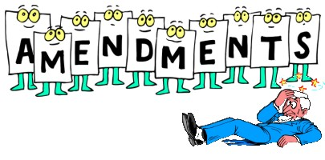
Art. II.12
No later than one month before the end of the project!

Slide 18

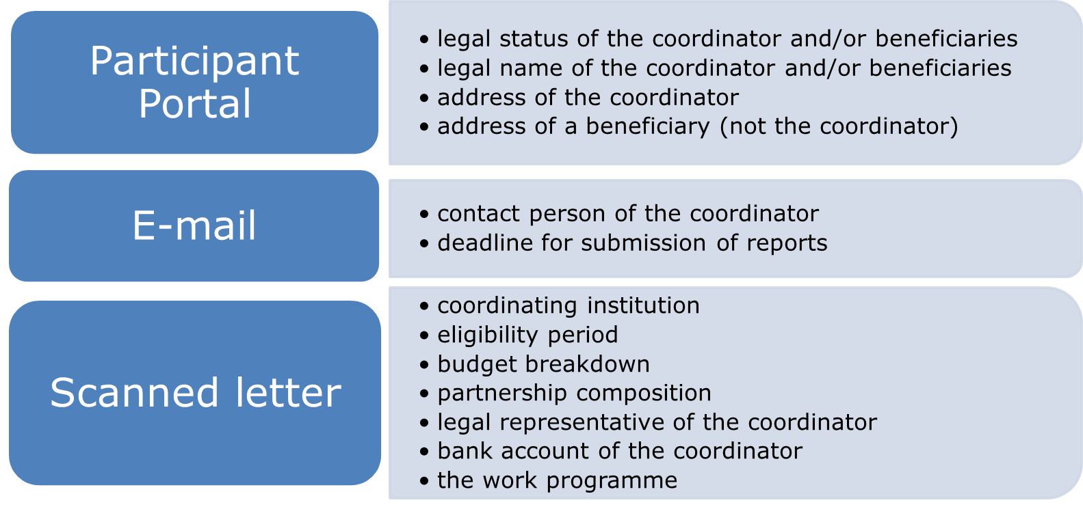

Amend it ! Art. II.12
Don't bend it

Slide 19
Before Asking for an Amendment
Principle: the application is the baseline for project implementation
Estimate the impact of the proposed change on the project:
  Compare this change/deviation with the initial work plan
  Make sure it stays within the scope of the project and complies with the programme's rules
  Who does it affect – one partner/the whole partnership?
  Does it have an effect on the project budget?
  Does it have an effect on the project timeframe?
  Any risk that the project will not deliver some of the planned outputs?
  Reflect on alternative solutions (fall-back plan)

Slide 20


Slide 21
REPORTING TO EACEA (Art. I.4)
E-reporting
Progress report (halfway through the project lifetime)
Final report (2 months after the end of the eligibility period)
Cover both the activities implemented and the grant used
Joint exercise : to be completed by and shared with all partners
Do not underestimate the amount of time necessary to write a report
Do not copy and paste information from other reports (/the application/other projects)
Answer the questions asked on the reporting template – no more no less
Be honest : present problems (and the remedial actions launched) as well as achievements

Slide 22
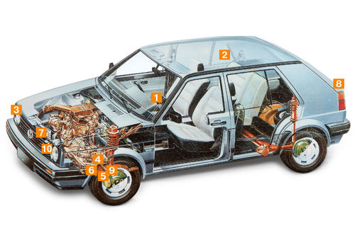
PENALTIES
Breach of contractual obligations Art.II.17.2 up to 10%
Publicity Art.I.10.9 -10
20% Reduction
Weak Implementation Art.10.6 up to 75%

Slide 23
Penalties for weak implementation (Art. I.10.6)
Reduction of the final grant in the event of weak implementation
When does the performance evaluation take place?
During the implementation of the project
  At Progress Report stage
  As a result of a Monitoring visit
After the completion of the project
  At Final Report stage

Slide 24
How will the project performance be assessed ?
  • Relevance (max. 30 pts)
  • Quality of the project (design and) implementation (max. 30 pts)
  • Quality of the project team and cooperation arrangements (max. 20 pts)
  • Impact and sustainability (max. 20 pts)
What could be the impact of a weak performance?
  25% : performance score between 40 points and below 50 points
  35% : performance score between 30 points and below 40 points
  55% : performance score between 20 points and below 30 points
  75% : performance score below 20 points

Slide 25
Needs analyses not taken into account; changes not communicated within reports; unexplained delays and no countermeasures proposed; no relation between activities and aims; no reference to continous relevance of expected results and objectives; repeating already funded activities; national legislation ignored
Recommendations not addressed; QA not developed "wikipedia" style; no access to documentation and products developed; insufficient information and analyses on design, development, accreditation/recognition and/or implementation; Underdeveloped webpage; Focus not on PC; Costs do not correspond to outputs

Slide 26
No conflict resolution mechanisms agreed; no efficient transfer of funds; meetings not minuted; cooperation not detailed in report; lack of involvement partners (also EU); university management not included
focus on indivual level only; no financial planning beyond contract period; accreditation not terminated; Weak ownership teams; technological or legal changes not addressed; no clarity how to measure impact (short and long term)

Slide 27
Publicity obligations (Art. I.10.9)
Sticker
  Project publications and results:
  Must display this Logo:
  Must mention " Co-funded by the Erasmus+ Programme of the European Union"
  https://eacea.ec.europa.eu/about-eacea/visual-identity_en
  Include disclaimer:
    "This project has been funded with support from the European Commission. This publication [communication] reflects the views only of the author, and the Commission cannot be held responsible for any use which may be made of the information contained therein".
  http://ec.europa.eu/dgs/education_culture/publ/graphics/beneficiaries_all.pdf

Slide 28
Penalties for non-compliance with publicity obligations (Art. I.10.10)
When does the performance evaluation take place?
At the same time as the performance assessment: i.e. at reporting stages as well as during field monitoring visits.
How are the publicity obligations verified?
Verification on project website and on the project documents (studies, reports, promotional material, etc.)
What is verified?
Respect of the Visual Identity
Presence of the acknowledgement on the co-funding of the Erasmus+ Programme
Presence of the Disclaimer concerning the content of the product

Slide 29
Administrative and financial Penalties
(Art. II.17 – General Conditions)
When?
When the beneficiary has
committed substantial errors, irregularities or fraud; or
made false declarations or failed to submit information; or
been in serious breach of contractual obligations.
What type of penalties could be applied?
Administrative penalties: exclusion of all contracts or grants for a max. duration of 5 years
Financial penalties: 2 to 10% of the beneficiary's grant contribution

Slide 30

QUESTION NOT ANSWERED?
Please contact the E+CBHE team
EACEA-EPLUS-CBHE-PROJECTS@ec.europa.eu
Don't forget to mention your project number!

Slide 31


