Slide 1
("Strengthening Capacities for Higher Education of Pain Medicine in Western Balkan Countries ") HEPMP Referent project number (585927-EPP-1-2017-1-RS-EPPKA2-CBHE-JP) Grant contract number (2017-3109/001-001)
2017 Capacity Building in the field of Higher Education (CBHE) project under the Erasmus+ program
“Strengthening Capacities for Higher Education of Pain Medicine in Western Balkan countries – HEPMP“
Project number: 585927-EPP-1-2017-1-RS-EPPKA2-CBHE-JP (2017 – 3109 / 001 – 001

Slide 2
2017 Capacity Building in the field of Higher Education (CBHE) project under the Erasmus+ program
“Strengthening Capacities for Higher Education of Pain Medicine in Western Balkan countries – HEPMP“
Project number: 585927-EPP-1-2017-1-RS-EPPKA2-CBHE-JP (2017 – 3109 / 001 – 001
Expenses are paid and presented in EUR
Local national currencies are converted via following web page
http://ec.europa.eu/budget/contracts_grants/info_contracts/inforeuro/inforeuro_en.cfm
Conversion is done in a month when EACEA executes
the payment of the first installment of coordinator prefinancing (December 2017.)
for all expenses incurred from the beginning of the project 15.10.2017.
up until second installment of prefinancing has
been paid to the coordinator by the EACEA.

Slide 3
Documents
2017 Capacity Building in the field of Higher Education (CBHE) project under the Erasmus+ program
“Strengthening Capacities for Higher Education of Pain Medicine in Western Balkan countries – HEPMP“
Project number: 585927-EPP-1-2017-1-RS-EPPKA2-CBHE-JP (2017 – 3109 / 001 – 001
Partnership agreement
Guidelines for the Use of the Grant
General and specific conditions of the Grant Agreement
Institutional policy
National legislation
Documents mentioned above refer to all budget categories:
Staff expenses
Travel costs and costs of stay
Costs of equipment
Costs of subcontracting

Slide 4
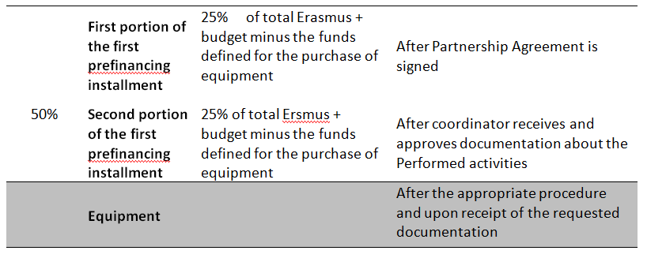
PAYMENT DYNAMICS
2017 Capacity Building in the field of Higher Education (CBHE) project under the Erasmus+ program
“Strengthening Capacities for Higher Education of Pain Medicine in Western Balkan countries – HEPMP“
Project number: 585927-EPP-1-2017-1-RS-EPPKA2-CBHE-JP (2017 – 3109 / 001 – 001

Slide 5
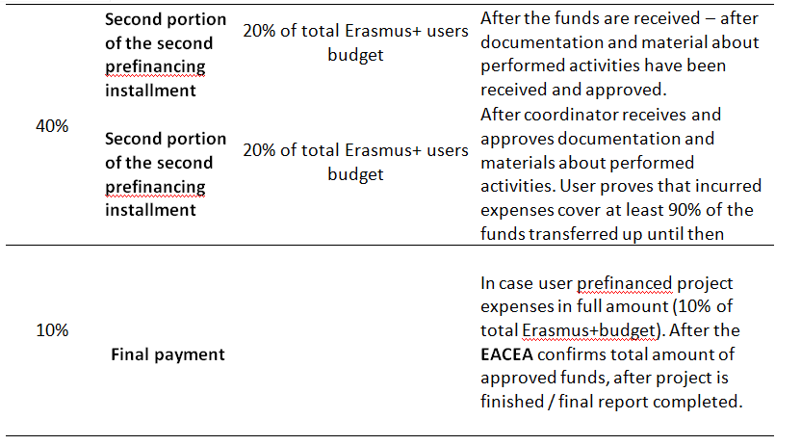
2017 Capacity Building in the field of Higher Education (CBHE) project under the Erasmus+ program
“Strengthening Capacities for Higher Education of Pain Medicine in Western Balkan countries – HEPMP“
Project number: 585927-EPP-1-2017-1-RS-EPPKA2-CBHE-JP (2017 – 3109 / 001 – 001

Slide 6
2017 Capacity Building in the field of Higher Education (CBHE) project under the Erasmus+ program
“Strengthening Capacities for Higher Education of Pain Medicine in Western Balkan countries – HEPMP“
Project number: 585927-EPP-1-2017-1-RS-EPPKA2-CBHE-JP (2017 – 3109 / 001 – 001
Suspension of payments !!!!!!!!!!!!
EACEA may suspend the payments in case irregularities have been detected (i.e. if constant and systematic errors, frauds and breach of rules have been detected during the course of the project)
Safe keeping of documentation
Original documentation will be preserved for a five year period. Preservation period starts from the day the final payment has been transferred by the EACEA to the coordinator.

Slide 7
EQUIPMENT
2017 Capacity Building in the field of Higher Education (CBHE) project under the Erasmus+ program
“Strengthening Capacities for Higher Education of Pain Medicine in Western Balkan countries – HEPMP“
Project number: 585927-EPP-1-2017-1-RS-EPPKA2-CBHE-JP (2017 – 3109 / 001 – 001
Equipment purchase rules contain in:
Partnership agreement
Guidelines for the Use of the Grant
General and specific conditions of the Grant Agreement-a
Institutional and national legislation have an important role in defining the procedure and how it is performed
Division of the contract into installments is forbidden, purchase is made all at once, for the entire equipment
Before purchase procedure is initiated, the coordination contact the EACEA
Accompanying documents:
Information and statements for all purchased equipment
Tender procedure documentation and offers of three different suppliers
Proof that the equipment has been recorded in the institutions fixed assets inventory

Slide 8
STAFF COSTS
2017 Capacity Building in the field of Higher Education (CBHE) project under the Erasmus+ program
“Strengthening Capacities for Higher Education of Pain Medicine in Western Balkan countries – HEPMP“
Project number: 585927-EPP-1-2017-1-RS-EPPKA2-CBHE-JP (2017 – 3109 / 001 – 001
Before funds have been transferred to staff members, benefactors must possess, following documents among others:
1. Authors work purchase contract, Service contract or other legally approved/prescribed formal type of employment agreement. Contract must signed and certified by the legal representative and stamped by project partner.
Contract is made in accordance with the institutional policy and the national legislation.
2. Joint declaration
3. Time sheet
4. Evidence of the performed work and results of the work performed or the work that was created, such as Report, Manual, textbook, record, technical specification etc.
5. Besides documents mentioned above list also contains other accompanying documents such as a request for fund payments

Slide 9
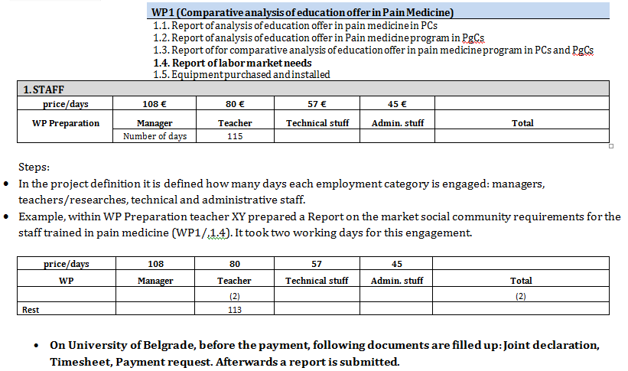
Example: Payment for a teachers engagement on the Project on University of Belgrade
2017 Capacity Building in the field of Higher Education (CBHE) project under the Erasmus+ program
“Strengthening Capacities for Higher Education of Pain Medicine in Western Balkan countries – HEPMP“
Project number: 585927-EPP-1-2017-1-RS-EPPKA2-CBHE-JP (2017 – 3109 / 001 – 001

Slide 10
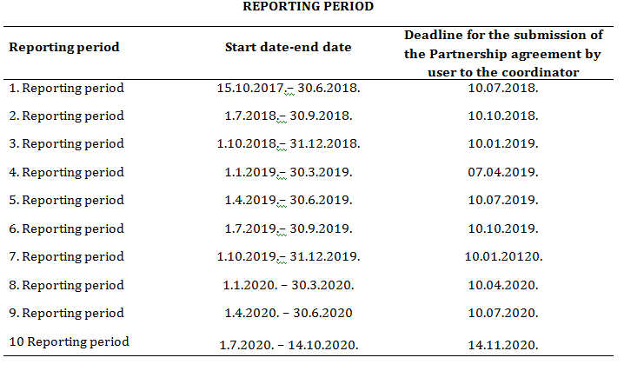
2017 Capacity Building in the field of Higher Education (CBHE) project under the Erasmus+ program
“Strengthening Capacities for Higher Education of Pain Medicine in Western Balkan countries – HEPMP“
Project number: 585927-EPP-1-2017-1-RS-EPPKA2-CBHE-JP (2017 – 3109 / 001 – 001

Slide 11
2017 Capacity Building in the field of Higher Education (CBHE) project under the Erasmus+ program
“Strengthening Capacities for Higher Education of Pain Medicine in Western Balkan countries – HEPMP“
Project number: 585927-EPP-1-2017-1-RS-EPPKA2-CBHE-JP (2017 – 3109 / 001 – 001
FINAL FINANCIAL STATEMENT
Proofs:
Costs incurred = Costs paid
Documents: Invoices, calculation of travel expenses, calculation of fees for participants in the project…. Forms: Individulal travel report, Time-sheet, Joint declaration | Evidence that invoices and obligations have been paid: - A copy of the bank or Treasury
The financial document is filled only with the fulfillment of both conditions.
The Progress report on the implementation of the action, together with the Financial Statement, is submitted at the half of the prојеct.
The report proves that 70% of the previous pre-financing payment was used.

Slide 12
2017 Capacity Building in the field of Higher Education (CBHE) project under the Erasmus+ program
“Strengthening Capacities for Higher Education of Pain Medicine in Western Balkan countries – HEPMP“
Project number: 585927-EPP-1-2017-1-RS-EPPKA2-CBHE-JP (2017 – 3109 / 001 – 001
…any Questions?

Slide 13
2017 Capacity Building in the field of Higher Education (CBHE) project under the Erasmus+ program
“Strengthening Capacities for Higher Education of Pain Medicine in Western Balkan countries – HEPMP“
Project number: 585927-EPP-1-2017-1-RS-EPPKA2-CBHE-JP (2017 – 3109 / 001 – 001
Thank You for the attention!

