Slide 1
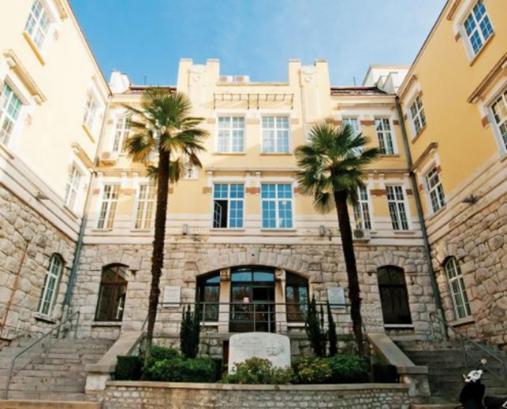



HEPMP
Higher Education Pain Medicine Project
Natural history of disc disease, surgical indications and review of minimally invasive intradiscal techniques
Dr. Josip Buric
www.sancamillofortedeimarmi.it

Slide 2
NATURAL HISTORY OF DISC HERNIATION

Slide 3
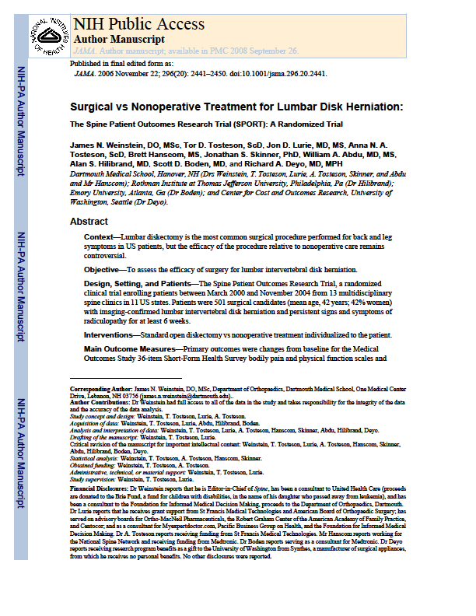
SPORT TRIAL

Slide 4

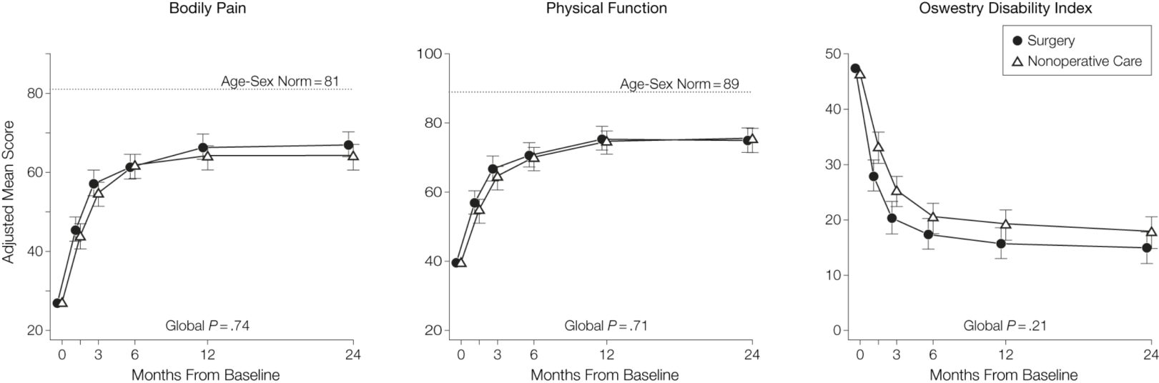
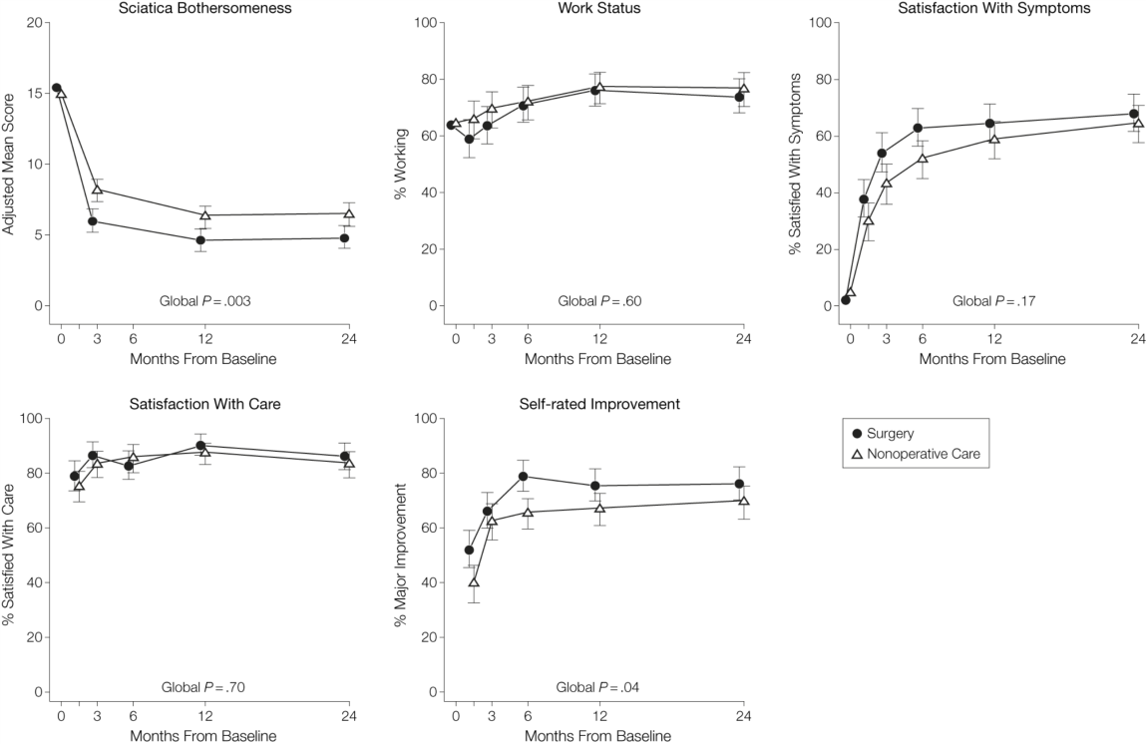
From: Surgical vs Nonoperative Treatment for Lumbar Disk Herniation: The Spine Patient Outcomes Research Trial (SPORT): A Randomized Trial - JAMA. 2006;296(20):2441-2450. doi:10.1001/jama.296.20.2441
Patients in both the surgery and nonoperative treatment groups improved substantially over the first 2 years
Between-group differences in improvements were consistently in favor of surgery for all outcomes and at all time periods but were small and not statistically significant except for the secondary measures of sciatica severity and self-rated improvement
Because of the high numbers of patients who crossed over in both directions, conclusions about the superiority or equivalence of the treatments are not warranted based on the intent-to-treat analysis alone

Slide 5
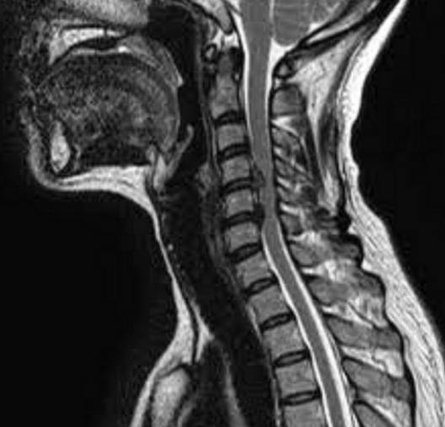
CERVICAL DISC HERNIATION
Wong J et al The course and prognostic factors of symptomatic cervical disc herniation with radiculopathy: a systematic review of the literature. The Spine Journal , Volume 14 , Issue 8 , 1781 – 1789 , 2013
8 articles (1221) treating on symtpomatic cervical disc herniations were identified
3 articles with low risk of bias
Substantial improvements tend to occur within the first 4 to 6 months post-onset
Time to complete recovery ranged from 24 to 36 months in, approximately, 83% of patients

Slide 6
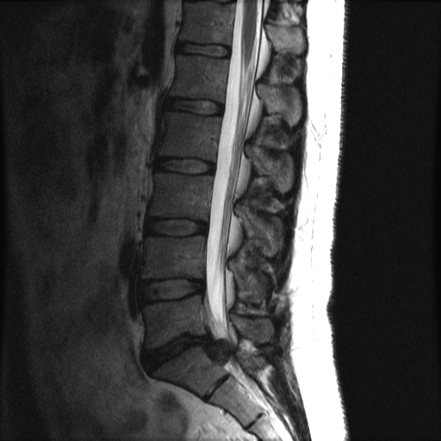
LUMBAR DISC HERNIATION - SEQUESTRATION
Macki M et al. Spontaneous regression of sequestrated lumbar disc herniations: Literature review.
Clinical Neurology and Neurosurgery , Volume 120 , 136 – 141, 2015
53 cases
Symptoms resolution - 1.33 ± 1.34 months
Radiographic resolution - 9.27 ± 13.32 months
Sequestrations may have the highest likelihood to radiographically regress in the shortest time frame in comparison to the remaining subtypes of LDH

Slide 7
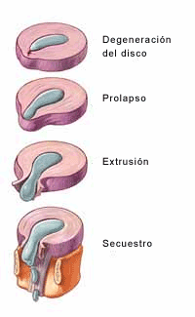
LUMBAR DISC HERNIATION
Chun-Chieh Chiu, Tai-Yuan Chuang, Kwang-Hwa Chang, Chien-Hua Wu, Po-Wei Lin, Wen-Yen Hsu. The probability of spontaneous regression of lumbar herniated disc: a systematic review. Clin Rehabil February 2015 vol. 29 no. 2 184-195
Articles including:
patients with lumbar disc herniation treated conservatively
have at least two imaging evaluations of the lumbar spine
excluded patients with prior lumbar surgery, spinal infections, tumors, spondylolisthesis, or spinal stenosis
31 articles included
9 articles applicable for probability calculation
Spontaneous regression: Complete resolution:
96% for disc sequestration 43% for sequestrated discs
70% for disc extrusion 15% for extruded discs
41% for disc protrusion
13% for disc bulging

Slide 8
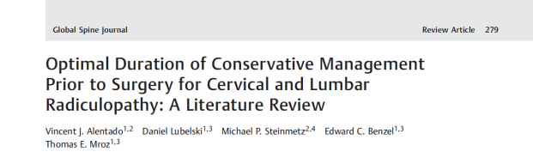
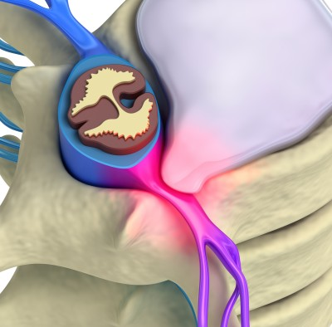
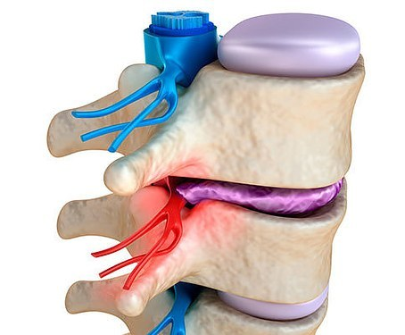
LUMBAR & CERVICAL DISC HERNIATION
13 studies (out 5719) were selected for inclusion.
Natural history studies demonstrated that 88% of patients with cervical radiculopathy and 70% of patients with lumbar radiculopathy showed improvement within 4 weeks following onset of symptoms
Outcomes and cost-effectiveness studies supported surgical intervention within 8 weeks of symptom onset for both cervical and lumbar radiculopathy.

Slide 9
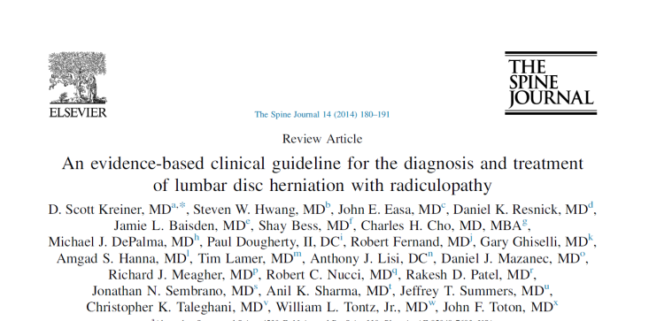
LUMBAR DISC HERNIATION
Question: what is the natural history of lumbar disc herniation with radiculopathy?
Kreiner et al. 2014 (NASS EBM GUIDELINES)
Work Group Consensus Statement
In the absence of reliable evidence relating to the natural history of lumbar disc herniation with radiculopathy, it is the work group’s opinion that most patients will improve independent of treatment.
Disc herniations will often shrink/regress over time.
Many, but not all, articles have demonstrated a clinical improvement with decreased size of disc herniations.

Slide 10
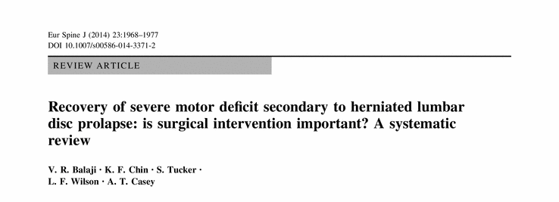
SEVERE MOTOR DEFICIT
Seven studies (354 pts) were identified
Complete recovery
38.4 % of patients following surgery
32 % following non-operative treatment
Age and grade of motor deficit were identified as significant prognostic factors in some of the studies
The current available evidence is not robust enough to address the questions posed.

Slide 11
SCIENTIFIC SOCIETIES RECOMMENDATIOTINS

Slide 12


NASS Coverage recommendations for surgery:
radiculopathy lasting > 6 - 12 weeks (resistant to conservative treatments) and compliant with image findings
bed riden pain < 6 weeks
palsy
cauda equina
infection
BASS recommendations for surgery:
75% of patients with radiculopathy will improve after 28 days
pts without improvement can be subimtted to surgery after 8 weeks to 4 months

Slide 13
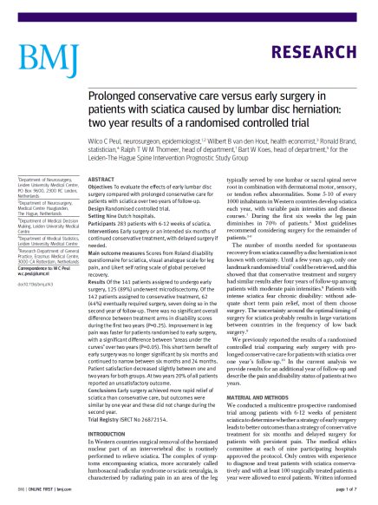
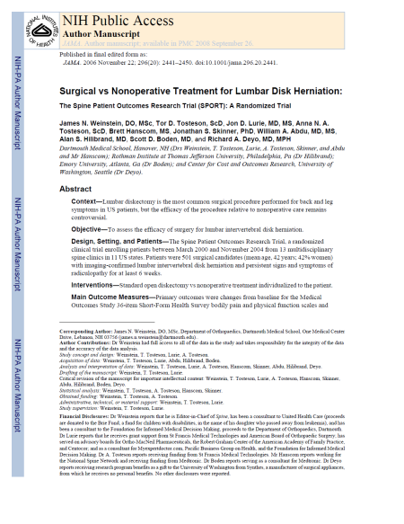
BASS complication rates:
death: 1/700
paralysis 1/300
infection: superficial 2-4% / deep 1%
durotomy: 3%
major blood vessel damage: 1/10,000
recurrence rate is between 5 and 15% on 10 years
Surgery is superior to non-surgical treatment on short FU (6 months)
After the first year, the results between surgery and non-surgical treatments, tend to equilize
20% of pts fail to both treatments

Slide 14
THE RATIONAL FOR THE USE OF PERCUTANEOUS PROCEDURES

Slide 15
LAYs IN THEIR ABILITY TO REDUCE OR ELIMINATE THE SYMPTOMS AND/OR THE PATHOLOGY
WHILE WAITING FOR THE NATURAL HISTORY COURSE
(LOWER RISK-COMPLICATION RATE)

Slide 16
WHICH TECHNIQUES ARE REALY USEFUL FOR THE TREATMENT?

Slide 17

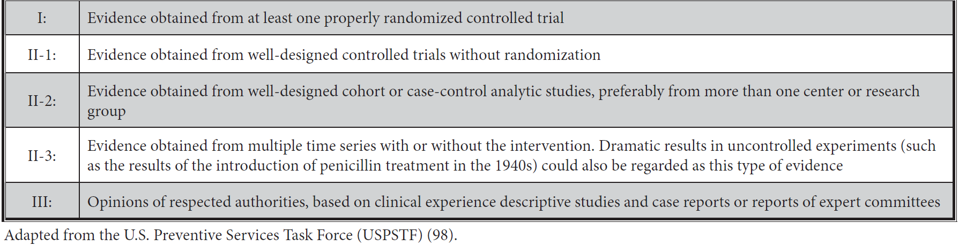
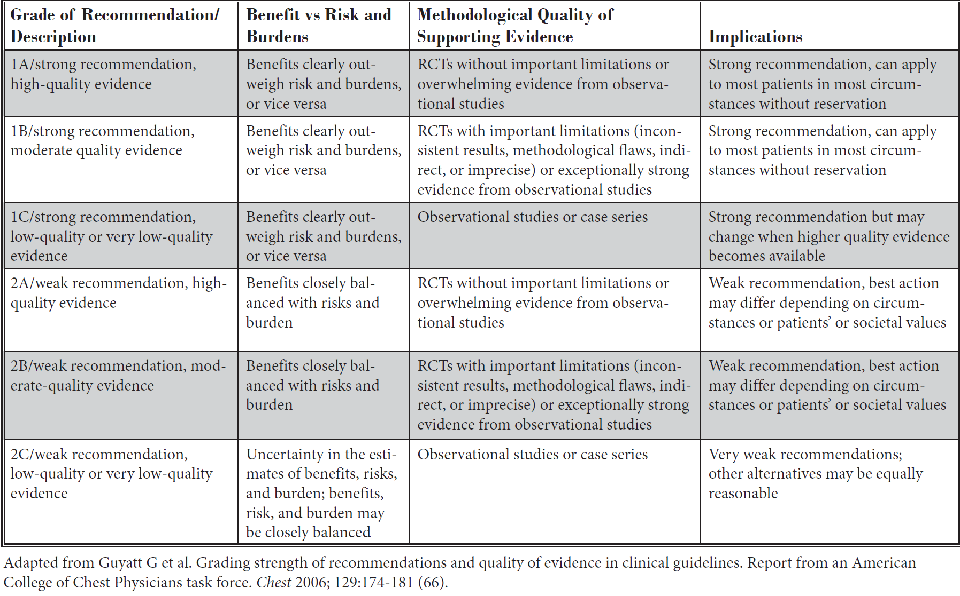
QUALITY OF EVIDENCE
RECOMMENDATIONS GRADING

Slide 18
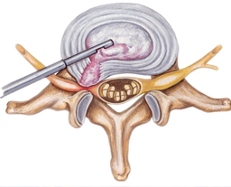
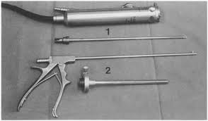
AUTOMATED PERCUTANEOUS MECHANICAL LUMBAR DISCECTOMY

Slide 19
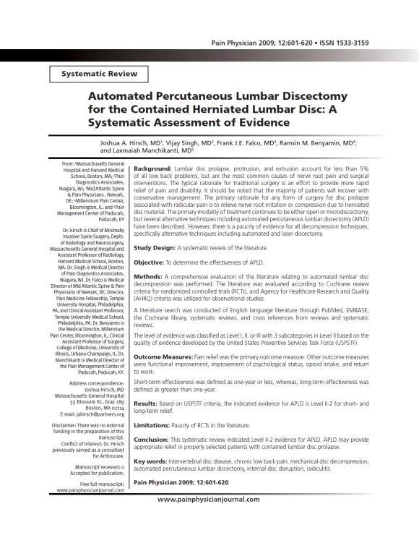
Randomized controlled trials – 4
Non-randomized observational studies – 76
Case reports and reviews for adverse effects
This systematic review indicated Level II-2 evidence, with 1C - strong recommendation for APLD
May provide appropriate relief in properly selected patients with contained disc herniation.
APLD is a safe procedure with minimal complications

Slide 20
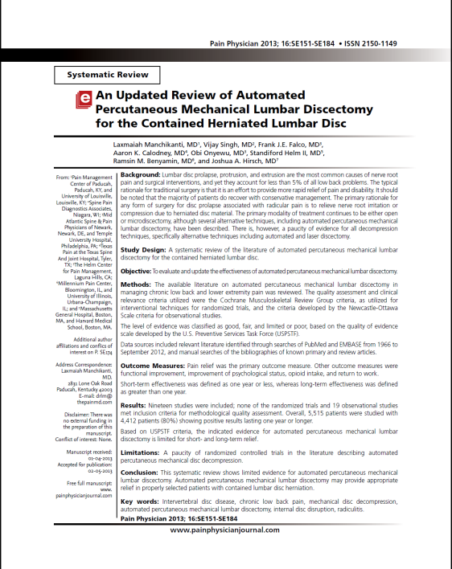
Randomized controlled trials – 0 (> 6 months FU)
Non-randomized observational studies – 19 (≥ 12 months FU) (5,515 patients)
Case reports and reviews for adverse effects
There is limited evidence for automated percutaneous mechanical lumbar discectomy.
Can, possibly, provide appropriate relief in properly selected patients with contained disc herniation.
It is a safe procedure with minimal complications.

Slide 21
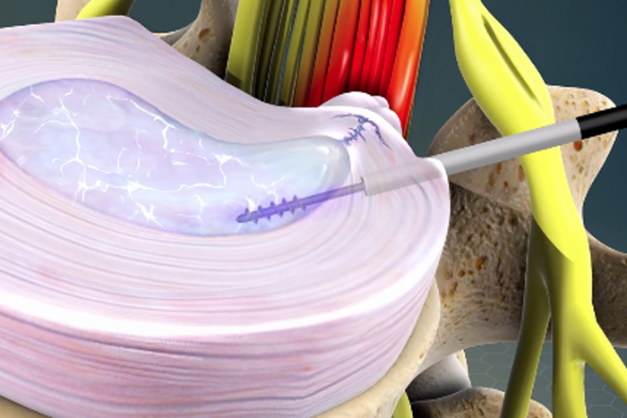
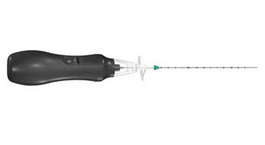
PERCUTANEOUS DECOMPRESSOR

Slide 22
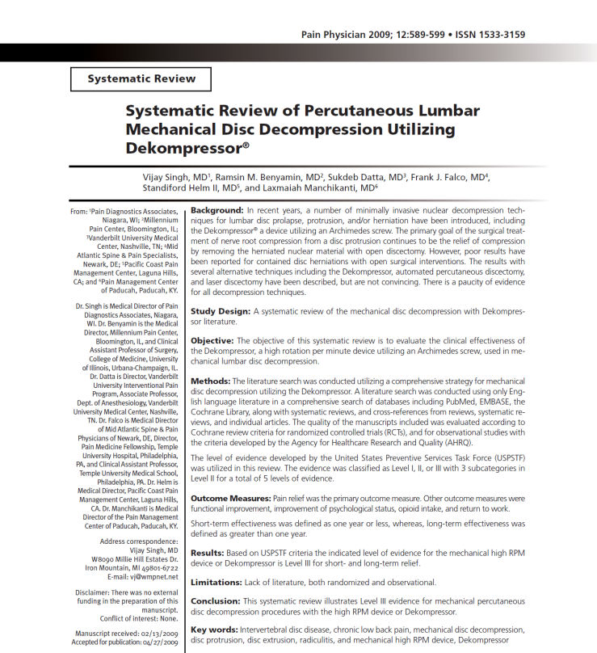
Randomized controlled trials – 0
Non-randomized observational studies – 4
Case reports and reviews for adverse effects
Based on USPSTF criteria, the indicated evidence for Dekompressor is Level III for short- and long-term relief.
The recommendation is 2C – very weak

Slide 23
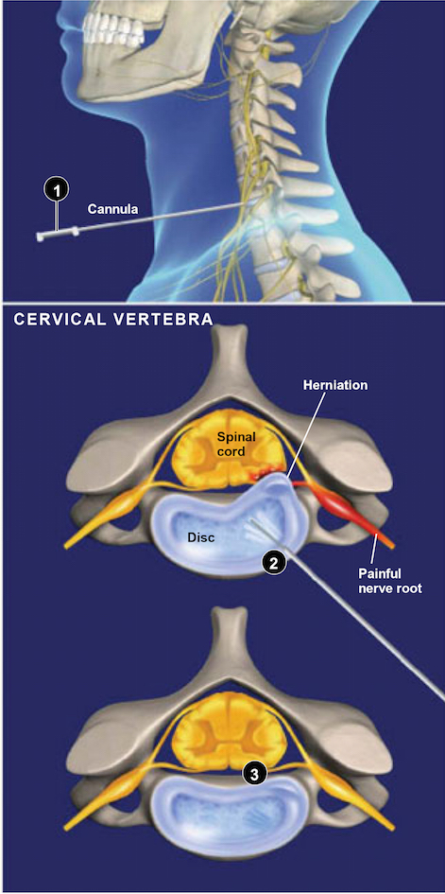
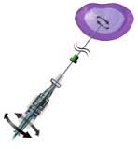
NUCLEOPLASTY

Slide 24
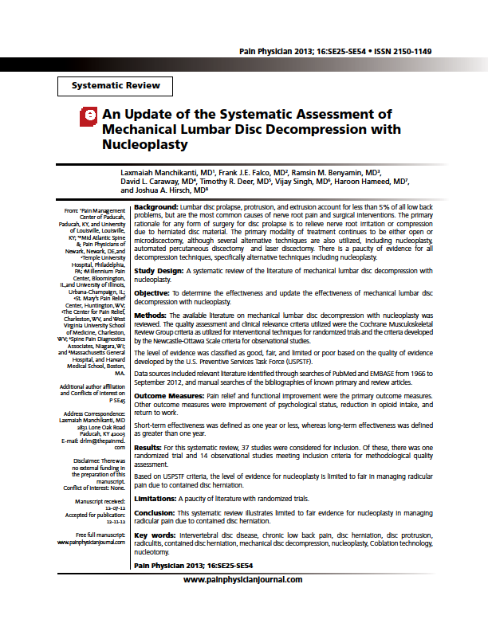
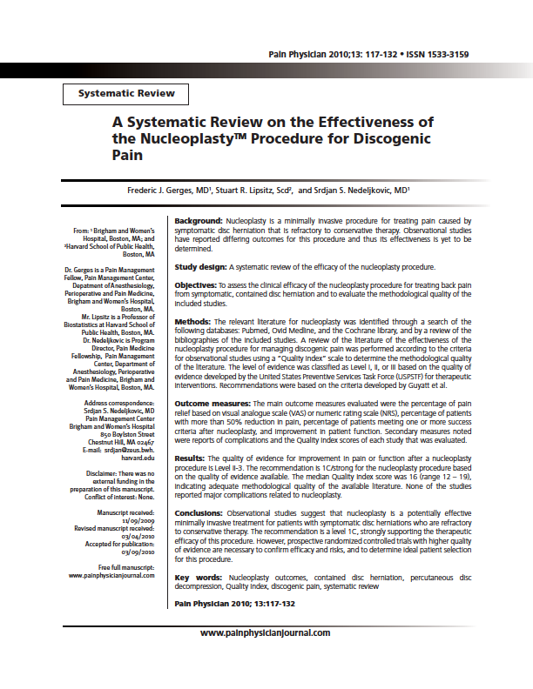
LUMBAR NUCLEOPLASTY
Randomized controlled trials – 1
Non-randomized observational studies – 14
Case reports and reviews for adverse effects
Based on United States Preventive Services Task Force (USPSTF) criteria, the indicated evidence
for Lumbar Nucleoplasty is Level II-3 (limited to fair)

Slide 25
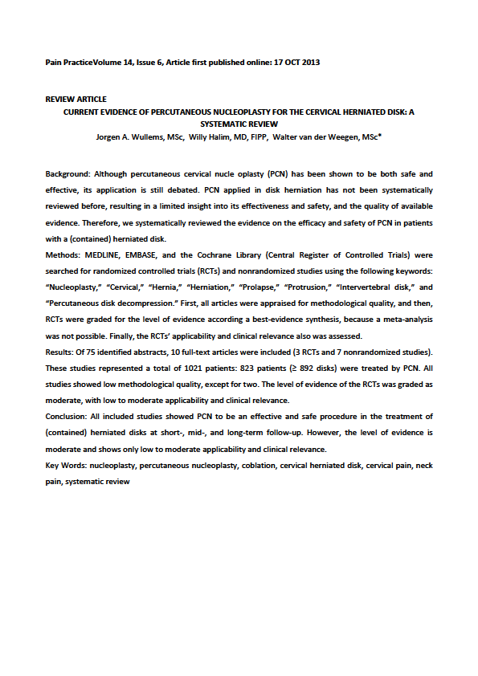
CERVICAL NUCLEOPLASTY
Randomized controlled trials – 3
Non-randomized observational studies – 7
Case reports and reviews for adverse effects
Based on United States Preventive Services Task Force (USPSTF) criteria, the indicated evidence for Cervical Nucleoplasty is moderate and clinical applicability low to moderate

Slide 26
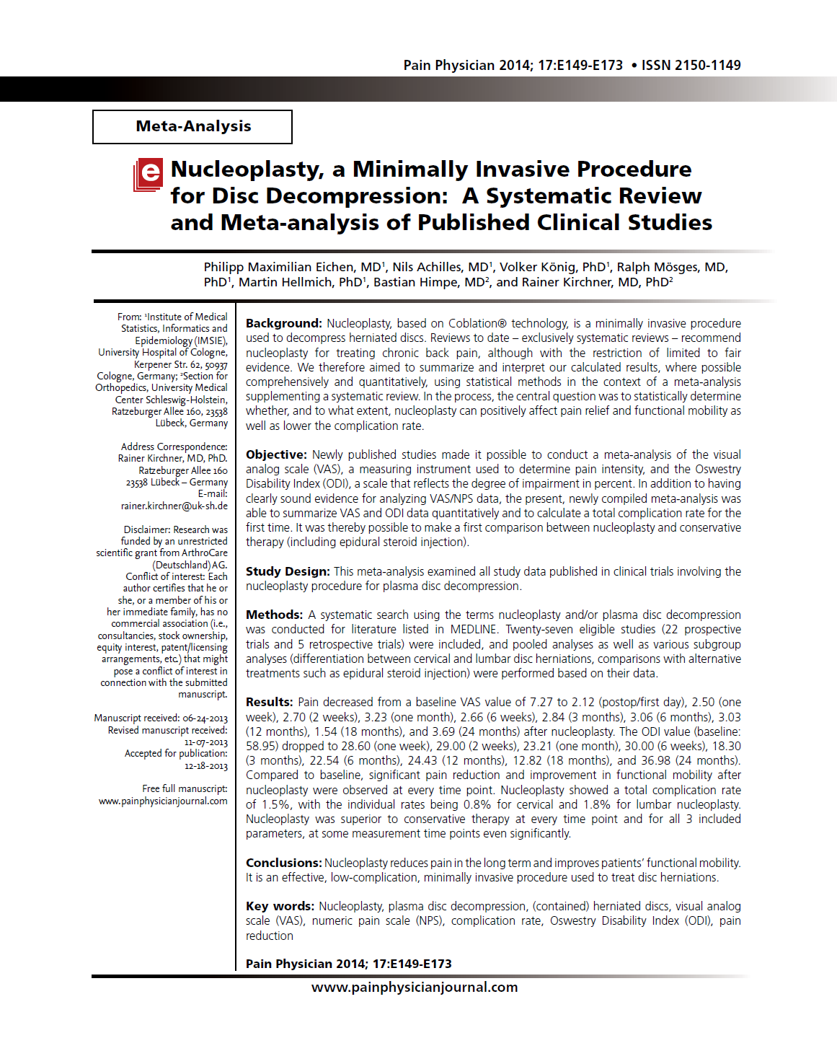
NUCLEOPLASTY
Randomized controlled trials – 0
Non-randomized observational studies – 27
22 prospective & 5 retrospective
Case reports and reviews for adverse effects
Under appropriate indications, Nucleoplasty provides long term pain releive and function improvement.
The overall results are better for cervical then lumbar levels

Slide 27
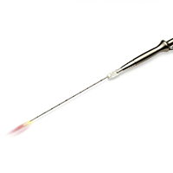
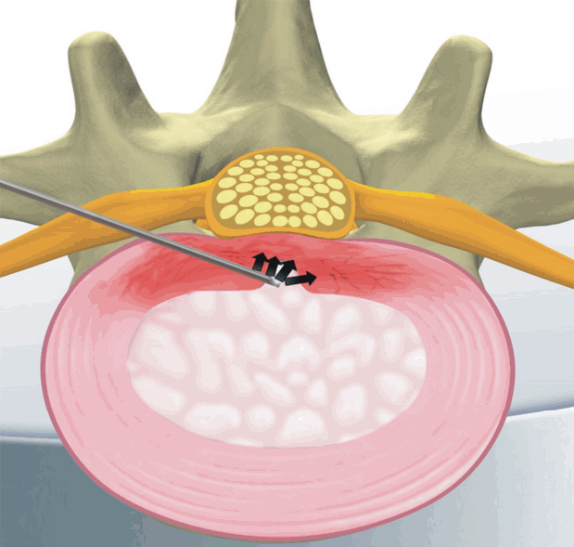
INTRADISCAL LASER

Slide 28
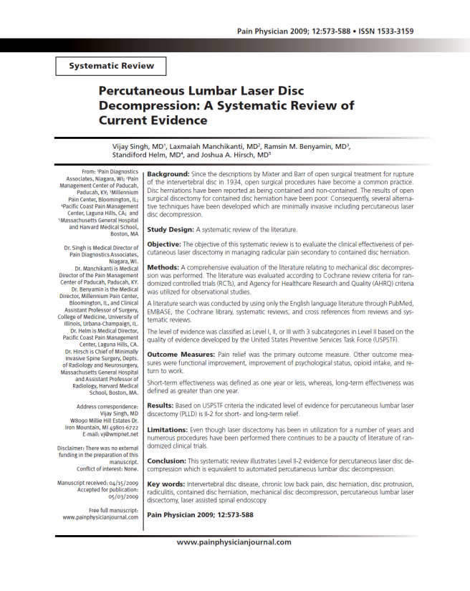
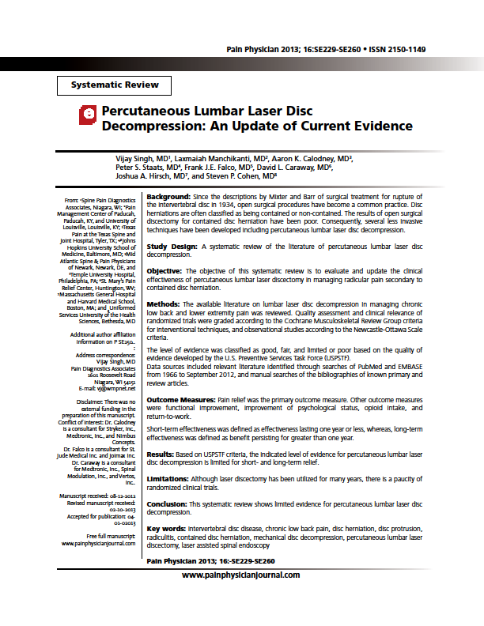
INTRADISCAL LASER
Randomized controlled trials – 0
Non-randomized observational studies – 33
Case reports and reviews for adverse effects
This systematic review shows limited short-term and long-term evidence for percutaneous lumbar laser disc decompression. Level of evidence II-2.
Recommendation is 1C - strong

Slide 29
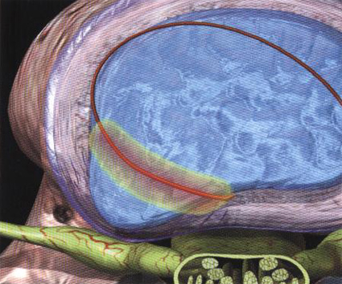
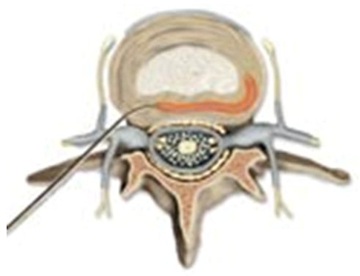
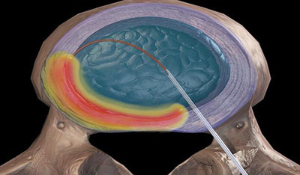
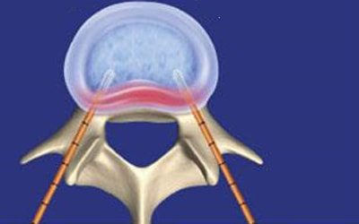
ELECTROTHERMAL PROCEDURES
IDET, DiscTRODE, BiAcuplasty

Slide 30
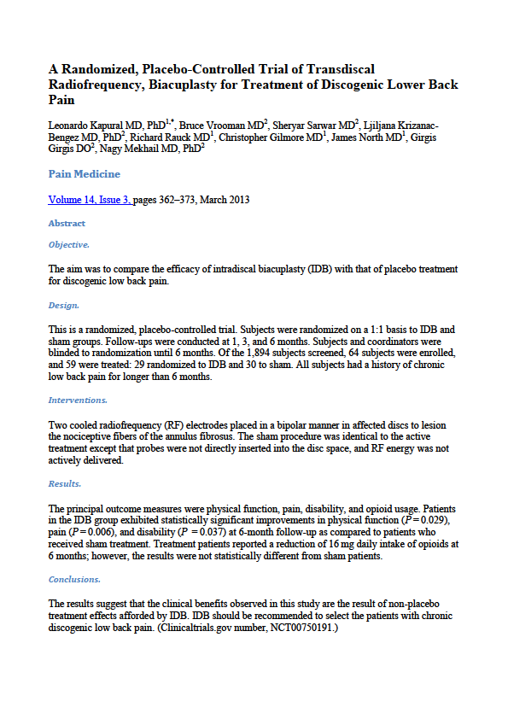
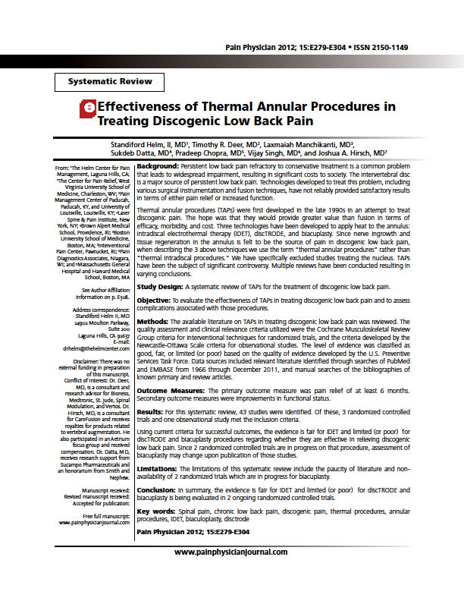
Randomized controlled trials – 3
Non-randomized observational studies – 10
Case reports and reviews for adverse effects
IDET - Evidence supporting the efficacy of IDET is weakly fair
DISCTRODE - There was only one study evaluating DiscTRODE which showed no benefit from the procedure; evidence is limited (or poor)
BIACUPLASTY - evidence for BiAcuplasty is limited (or poor) 2 randomized controlled trials are in progress on that procedure

Slide 31
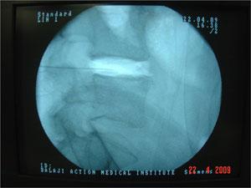
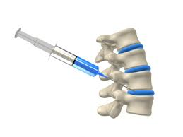
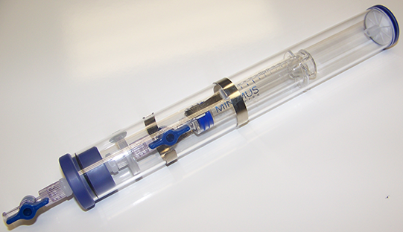
INTRADISCAL OZONE

Slide 32
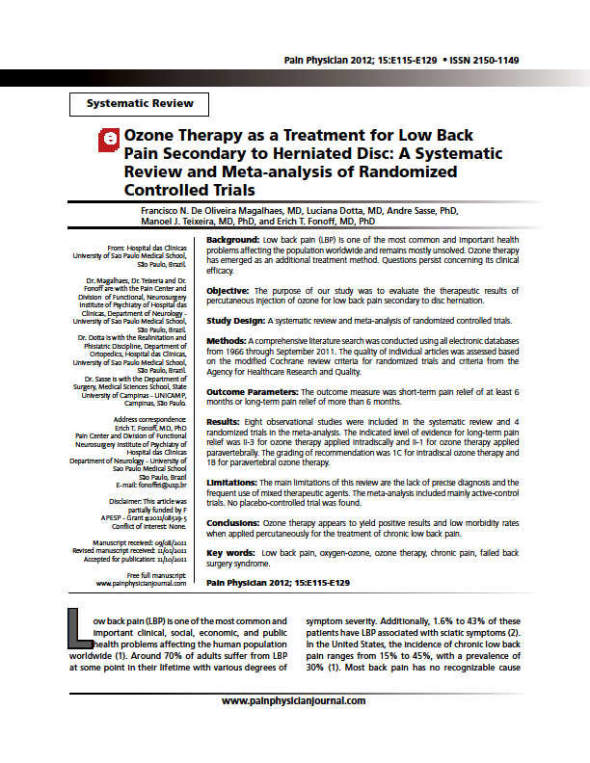
Randomized controlled trials – 4
Non-randomized observational studies – 8
Case reports and reviews for adverse effects
This systematic review shows limited short-term and long-term evidence for intradiscal ozone. Level of evidence II-3.
Recommendation is 1C - strong

Slide 33
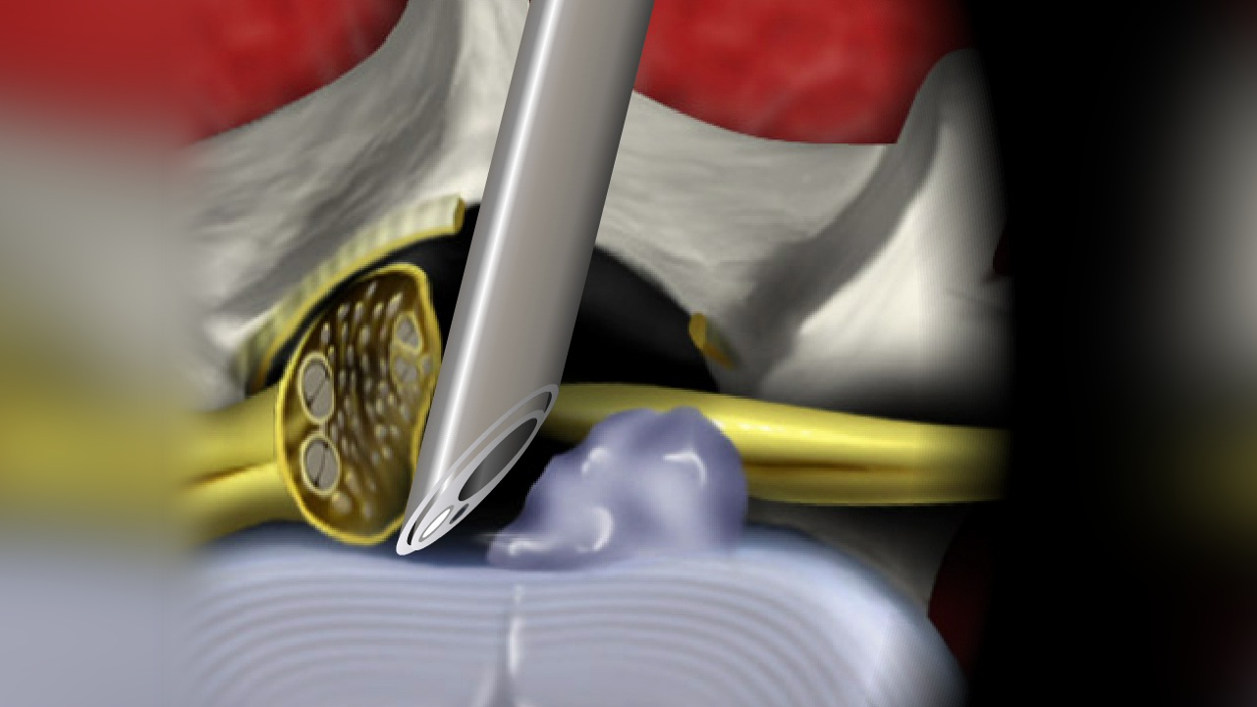
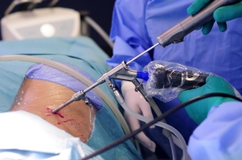
ENDOSCOPIC & MECHANICAL DISCECTOMY

Slide 34
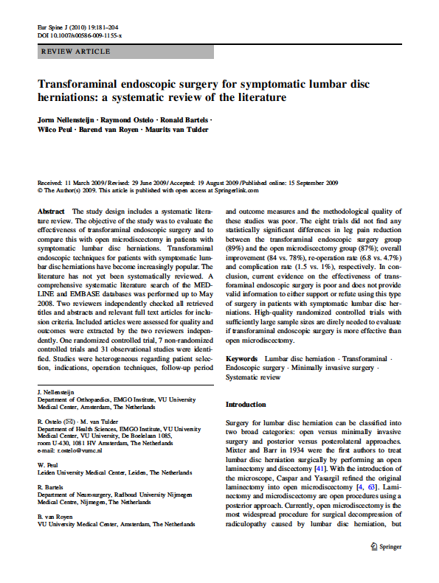
Randomized controlled trials – 1
Non-randomized observational studies – 38
Case reports and reviews for adverse effects
Current evidence for endoscopic surgery is poor and does not provide valid information to either support or refute using this type of surgery in patients with symptomatic lumbar disc herniations

Slide 35
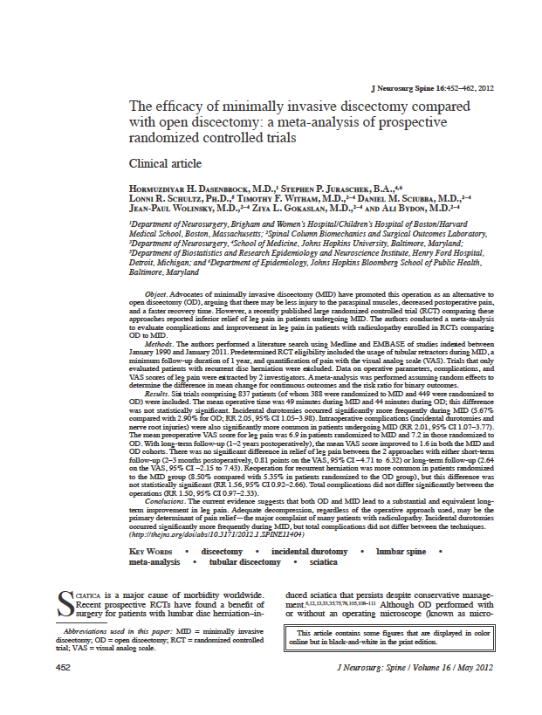
Randomized controlled trials – 6 (837 pts)
Non-randomized observational studies
Case reports and reviews for adverse effects
Current evidence suggests that both OD and MID lead to a substantial and equivalent long-term improvement in leg pain.
The MID showed lower complication rate but higher recurrence rate.

Slide 36
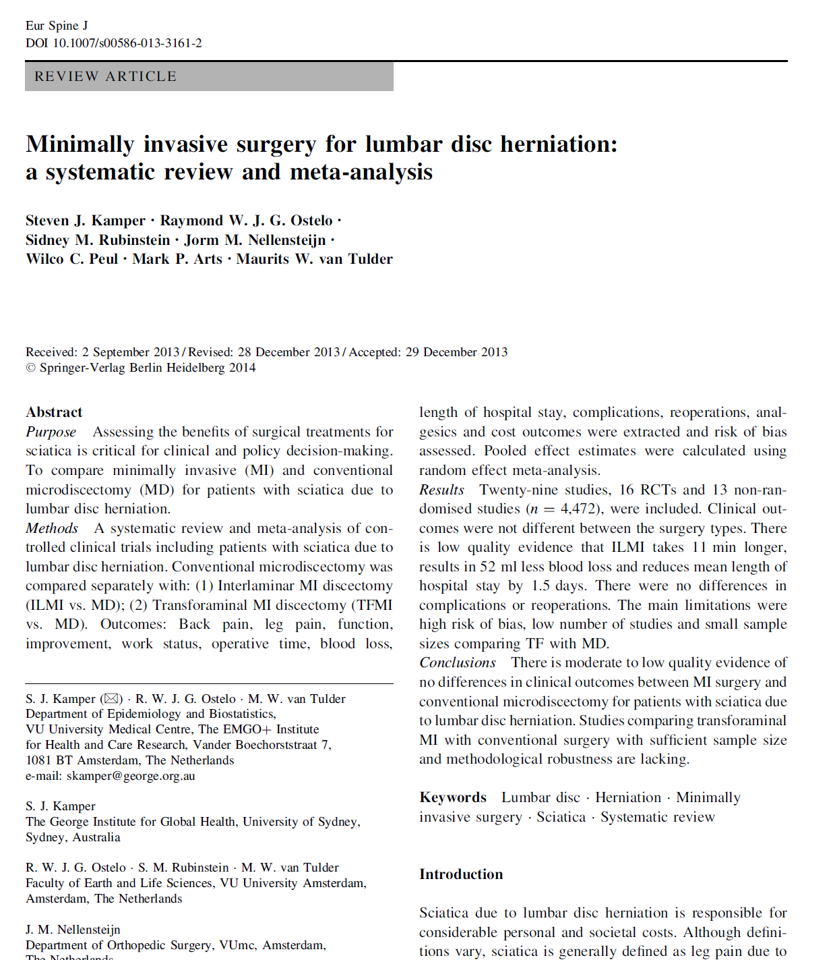
Randomized controlled trials – 16
Non-randomized observational studies - 13
Case reports and reviews for adverse effects
Modearte to low quality evidence of no differences in clinical outcomes between MID and MD
Less blood loss, shorter hospital stay and longer surgical times

Slide 37

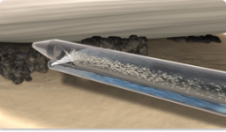
HYDROCISION

Slide 38
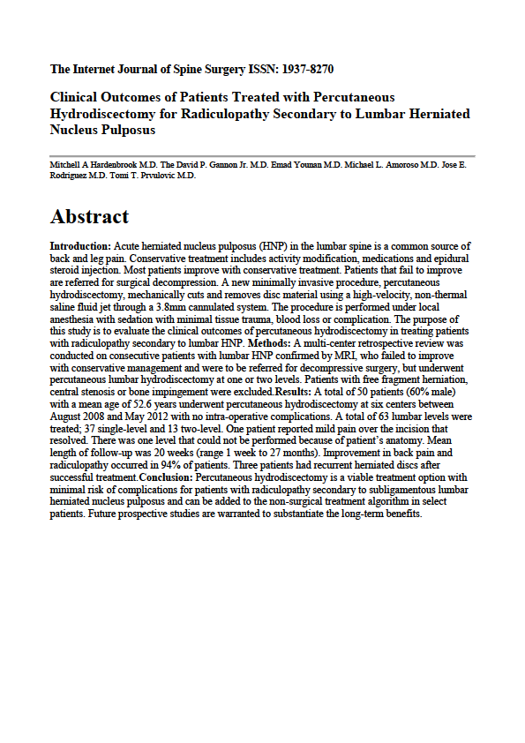
Retrospective multi-center study reviewed by New England Institutional Review Board (NEIRB #11-020) conducted on consecutive patients that had percutaneous hydrodiscectomy with 6 months F-U
Short-term clinical success was 94%
No long-term litterature

Slide 39
HYDROCISION
Cristante AF, Dias da Rocha I, Marcon RM, et al. Randomized study comparing lumbar microdiscectomy with SpineJet in the treatment of lumbar disc protrusions. Publication pending, 2013

Slide 40


INTRADISCAL PULSED RADIO FREQUENCY

Slide 41

Randomized controlled trials – 0
Non-randomized observational studies - 3
Case reports and reviews for adverse effects
Low number of patients.
No clinical evidence.
Potentially useful for discogenic low back pain

Slide 42


INTRADISCAL PLATELET RICH PLASMA

Slide 43

Randomized controlled trials – 0
Non-randomized observational studies - 3
Case reports and reviews for adverse effects
3 “in vitro” and 3 “in vivo” studies indicate positive results although no definitive conclusions can be drawn at the moment.

Slide 44
No safety concerns. The procedure is safe although the clinical efficacy is still to be determined.

Slide 45
CONCLUSIONS

Slide 46
PROCEDURE | LEVEL OF EVIDENCE | RECOMMENDATION
APLD | II – 2 | 1 C strong/low quality evidence
DECOMPRESSOR | III | 2 C weak/low quality evidence
NUCLEOPLASTY | II - 3 | LOW - MODERATE
LASER | II – 2 | 1 C strong/low quality evidence
ELECTROTHERMAL | II – 3, III | 2 C weak/low quality evidence
OZONE | II – 3 | 1 C strong/low quality evidence
ENDOSCOPIC | NO DEIFFERENCE WITH | DISCECTOMY
HYDROCISION | II - 3 | 2 C weak/low quality evidence
PRF | III | 2 C weak/low quality evidence
PRP | III | 2 C weak/low quality evidence

Slide 47
PROCEDURE | LEVEL OF EVIDENCE | RECOMMENDATION
APLD | II – 2 | 1C - strong low quality evidence
DECOMPRESSOR | III | 2C - weak low quality evidence
NUCLEOPLASTY | II - 3 | LOW – MODERATE
LASER | II – 2 | 1C - strong low quality evidence
ELECTROTHERMAL | II – 3, III | 2C - weak low quality evidence
OZONE | II – 3 | 1C – strong low quality evidence
ENDOSCOPIC | NO DEIFFERENCE WITH | DISCECTOMY
HYDROCISION | II - 3 | 2C – weak low quality evidence
PRF | III | 2C – weak low quality evidence
PRP | III | 2C – weak low quality evidence

Slide 48
IN CONCLUSION WE CAN SAY THAT UNDER PROPER INDICATIONS MINIMALLY INVASIVE, PERCUTANEOUS,
INTRADISCAL PROCEDURES ARE A USEFUL AND COST EFFECTIVE TREATMENT
THAT SHORTENS THE SYMPTOMS TIME WHILE
WAITING THAT THE NATURAL HISTORY ACCOMPLISHES ITS COURSE

Slide 49

www.sancamillofortedeimarmi.it
THANK YOU

