Slide 1
X-rayed guided block of different body parts
Prim.dr.sc. Kalagac Fabris Lada,dr.med.
Ambulanta za liječenje boli
Opća Bolnica Pula

Slide 2
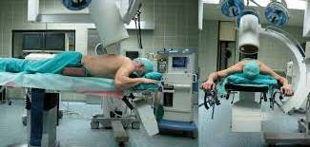
Patient position and C-arm alignment
The patient’s position is chosen with three factors in mind:
Safety
Access for the block
Patient confort
… in this order of priority !!!
Safety is first and requires a clear understanding of the anatomy, thus the description of each block begin with the discussion of the relevant regional anatomy. To minimize radiation exposure, the X-ray source is tipically kept under the x-ray table.
When the patient is placed prone without angulation of the C-arm, an anterior-posterior radiograph is obtained, and when is placed supine a posterior –anterior radiograph is present. Lateral movement of the C-arm from the saggital plane is termed oblique angulation. When C-arm is angled away from the axial plane toward the head – cranial angulation, when toward the the foot - caudal angulation.
Minimizing patient and practitioner radiation exposure ( minimize dose and time, optimize the position of x-ray tube, employ proper shielding, pactiotioner position)

Slide 3
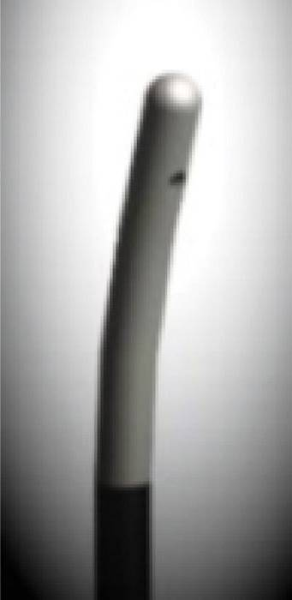
Avoiding critical structures is best accomplished at the outset in planning the approach for neural blockade, it will be apparent that the same target can be approached from many different angles. Although some approaches are actually simpler to perform, they are best reserved for experienced practioners because of the inherent dangers in getting confused by the complex radiographic anatomy of the spine.
As regards safety, the underlying principle is “ the coaxial technique” for the needle placement – the advancing needle and the x-ray path share a common axis. In this way, the needle tip is advanced from the skin surface to the final target at a depth with only small changes in the needle direction. The needle tip and the target are seene all the times.
The most common needle used for image-guided injection is the 22-gauge,
3,5-inch (~10cm) Quincke spinal needle. The Quincke point is sharp and
advances easily through most tissue. The 22-gauge diameter is a reasonable
compromise between needle diameter and stiffness. Although smaller diameter
needles produce slightly less pain during placement, they lack lack stiffness
and tend to bend easily. The new blunt-tip and curved tips needles are supposed
to allow less penetration through nerves or arteries and can be easier steered
during it’s placement. For the interlaminar route of “ESI” the most used is the
Tuohy needle of 18-20 gauge diameter and 8 cm in length.
Blunt needle
Epimed
Most patients are more confortable in supine position than in the prone position, particulary for cervical injections. ( emply proper shielding, radiographic contrast agent, local anesthetic and steroid preparations)

Slide 4
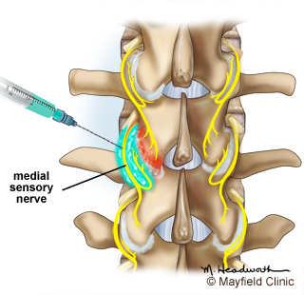
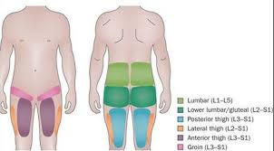
Facet block ; intra-articular injection
Anatomy:
The zygapophysial or “facet” joints are paired structures that lie posterolaterally on the bony vertebrae at the junction of the lamina and pedicle medially, and the base of the transverse process laterally. They are true joints, with opposing cartilaginous surfaces and true synovial lining, and they are subjected to inflammation and degeneration. Each facet joint receives sensory innervation from medial branch nerve at the same vertebral level, as well as from a descending branch from the vertebral level above; thus, two medial branch nerves must be blocked to anesthetized each facet joint.
Patient selection :
Axial pain that tends to be exacerbated by movement, particularly flexion-extension or rotation of the spine. The quality of the pain is tipically deep and aching, and waxes and wanes with activity. Typical pain patterns are in the axial lower back, sometime gluteal and the back of the thighs but it never go under the knees.

Slide 5
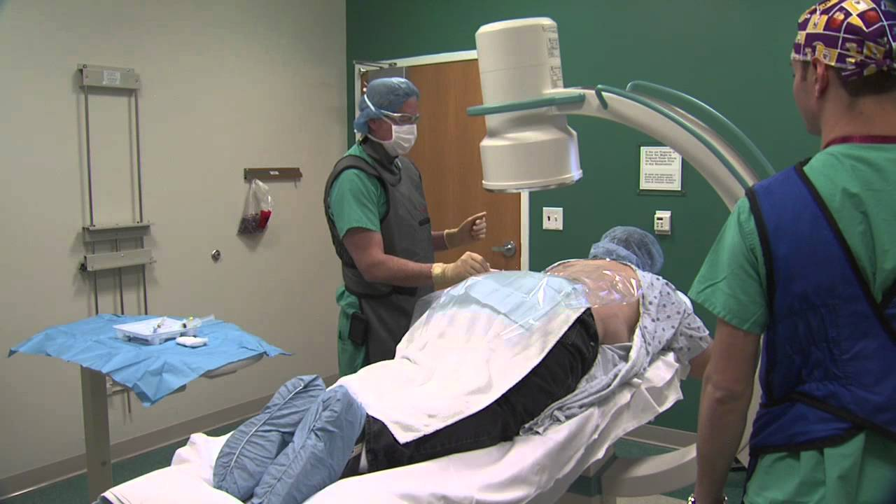
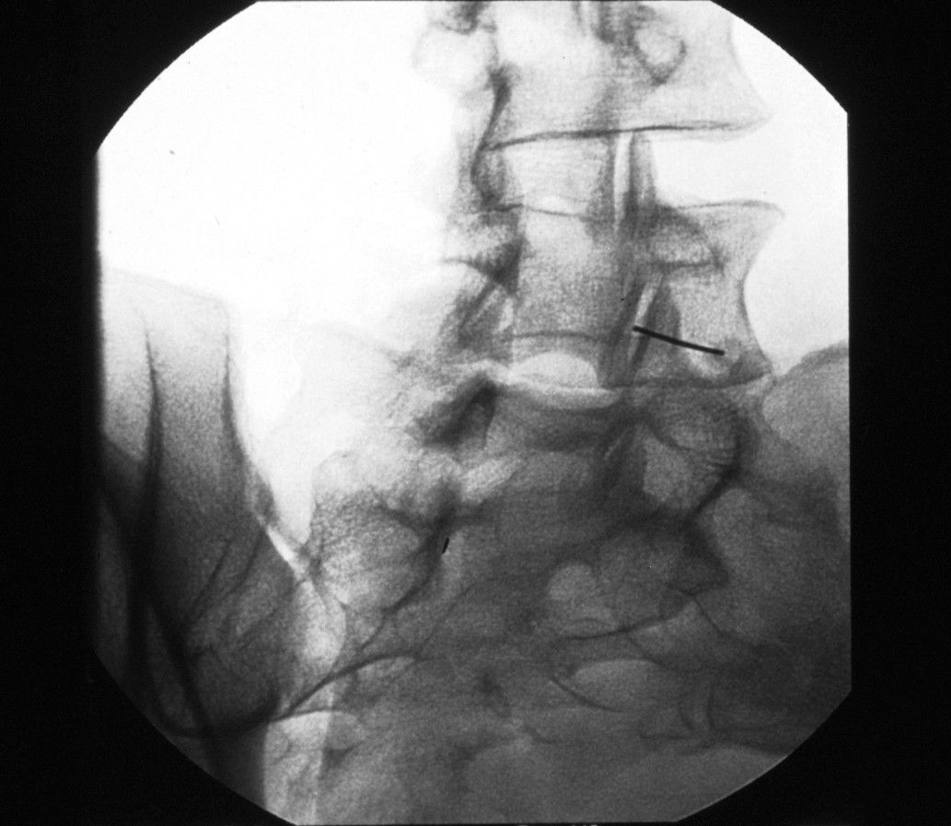
Positioning:
The patient is positioned prone with a pillow under the abdomen to flatten the lumbar lordosis. If necessary, sedation should be light in order to enable communication with the patient. Firstly, the anatomical structures are identified with an arterior posterior view.
The C-arm is angled obliquely 25 to 35 degrees from the sagital plane to the ipsilateral side and without caudal angulation. The target is the cephaled junction between the superior articular process and the transverse process.

Slide 6
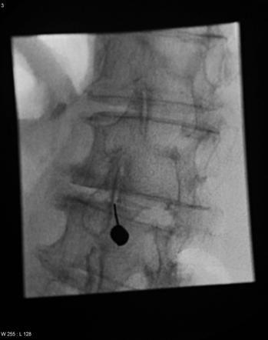
Block technique:
The contours of the posterior bony elements of the spine on the oblique projection take a shape similar to the silhouette of a “Scotty dog”. Following this contour around its perimeter, the front leg of the dog is the inferior articular process of the vertebra,the snout is the transverse process, the ear is the superior process, the back is the superior margin of the lamina, the buttocks and hind leg is the spinous process.
A 22-gauge, 3.5 inch spinal needle is adjusted to remain coaxial and is advanced slightly in acranial direction toward the base of the transverse process, where it joins the superior articular process and is seated on the bony margin.
In the lateral fluoroscopic view, the needle tip should now lie at the base of the superior articular process in the plane formed by the so-called facet column at the lower aspect of the intervertebral foramen, approximately 1mm dorsal to its posterior border.
The target point can be marked by 1ml of radiopaque-contrast, or directly injected 0.5%bupivacaine and cortisone in 1:1mixture ( 1-2 ml for each level)

Slide 7
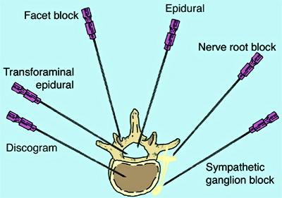
Lumbar transforaminal and selective spinal nerve injection
The distintion between the two tecniques is questionable because the fascial sheath surrounding the spinal nerves is contiguous with the dura mater within the epidural space.
The term “ selective spinal nerve injection” is reserved for the injections that are performed with the needle tip adjacent to the spinal nerve, outside to the intervertebral foramen.
The term “transforaminal injection” indicate the injections that are performed with the needle tip within the intervertebral foramen.
The rational for using a transforaminal route is that the injection rather than an interlaminar route is that the injectate is deliveered directly into the target nerve. This ensures the medication reaches the target area in maximum concentration at the site of suspected pathology. The rationale for injecting steroids is that they suppress inflammation of the nerve, which is believed to be the basis for radicular pain.

Slide 8
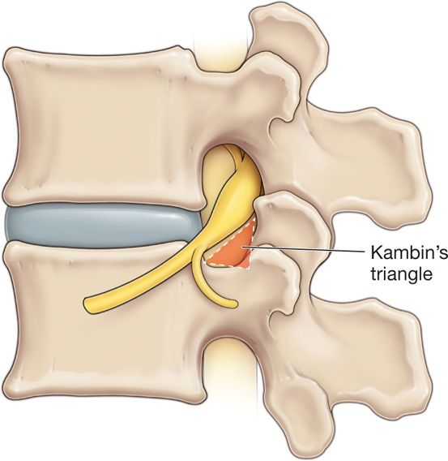
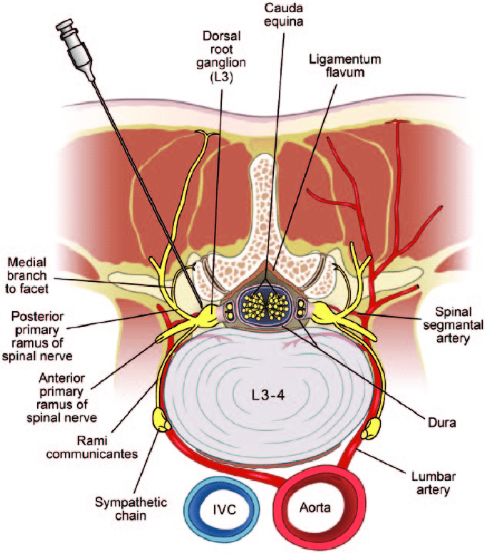
Anatomy: the foramen faces laterally.
Its roof and floor are formed by the pedicles of adjacent vertebrae.
Its posterior wall is formed largely by the superior articular process of
the lower vertebra and, in part, by the inferior articular process of the
upper vertebra and the capsule of the zygapophysial joint between the
two articular process. The anterior wall is formed by the vertebral body
and the intervertebral disc.
The spinal nerve, in its dural sleeve; lies in the anterior and superior portion of the foramen, just inferior to the pedicle.
Spinal segmental arteries arise from the aorta and the iliac vessels and accompany the spinal nerve and its roots to the spinal cord.
The artery typically enters the foramen along its ventral aspect within the superior half of the foramen. The largest of the spinal segmental arteries is called the artery of Adamkiewicz and enter the spinal canal from the left side between T9 and L1 in n80% of individuals. However, the artery of Adamkiewicz can enter the spinal canal anywhere from T7 to L4.
The final needle position during selective nerve root or transforaminal injection
lies in close proximity to both the spinal nerve and the spinal segemental artery !!!

Slide 9
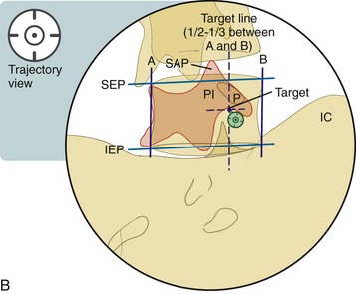
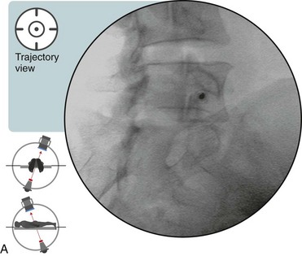
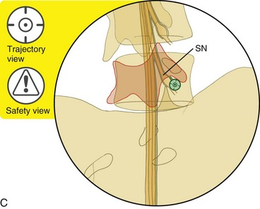
Patient selection : RADICULAR SYMPTOMS
due to acutely herniated intervertebral disc,
isolated foramminal stenosis due to spondylitic spurring of the bony margins of the foramen
diagnostically to determine wich spinal nerve is causing symptoms in co-existing pathology
Positioning:
patient lies prone with the head turned to one side
The C-arm from the centered position is ROTATED 20 to 30 degrees lateral oblique (to the lesion side) to allow the needle toward the superolateral aspect of the intervertebral foramen, and tilted cranially or caudally at 0-5 degrees if needed to align the vertebral end plates.
The contour of the posterior bony elements of spine take the shape similar to the silhouette of a Scottish terrier : the snout is the transverse process, the ear is the superior articular process, the front leg is the inferior articular process of the vertebra

Slide 10
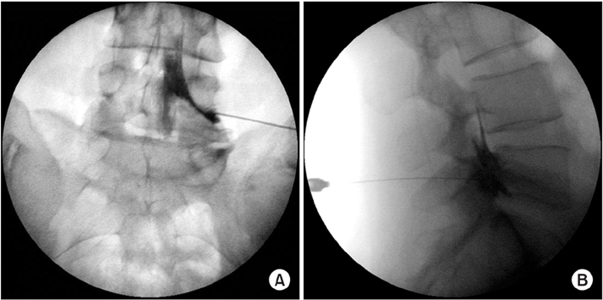
Block technique:
The needle is advanced under the chin of the scottish dog (toward the superior aspect of the intervertebral foramen, just inferior to the pedicle and inferolateral to the pars interarticularis). The tip can be advanced using coaxial technique, once the bony margin is contacted, the C-arm is rotated to a lateral view and the needle is slowly advanced. If paresthesia is reported by the patient at any time during the needle advancement, the needele should be withdrawn slightly, and the position confirmed with radiographic contrast.
With the needle in final position, 1-2 ml of radio-contrast is injected under “live” or “real-time” fluoroscopy in the AP plane to ensure the needle tip lies in close proximity to the nerve without any intravascular or intratechal spread. Only after positive response is allowed to injectate local anesthetic and steroid safely.

Slide 11
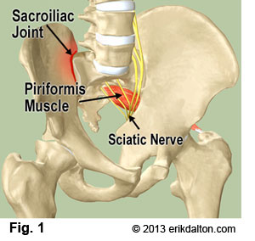
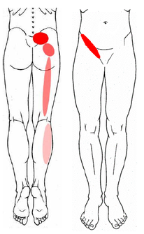
Sacroiliac joint injection
Anatomy:
The SI joint are largely stiff fibrocartilaginous connections, with the true synovial joint lyng largely in the anterior aspect of the junction between the sacrum and the illium. The true joint space extends to the inferior and the posterior extent of the SI apposition, where it is accessible to injection.
The joint lies with 0 to 30 dergees of oblique angulation from the sagittal plane.The anterior portion of the joint arcs laterally. The extensive sensory innervation of the SI joints arise anteriorly from the branches of the lumbar plexus and the L5 dorsal ramus S1 to S3 lateral branches posteriorly. Only the posterior aspect of the joint can be accessed with the safety and ease percutaneously.
Patient selection : pain my be referred to the posterior thigh, but extending below the the knee is unusual. Physical examination my reveal localized tenderness over the joint, and Faber or Patrick’s test and Gaeslen test my reproduce pain in the area of the SI joint positive. Degenerative change of the joint on radiography is uncommon and nonspecific.

Slide 12
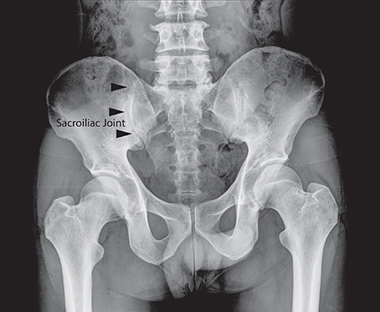
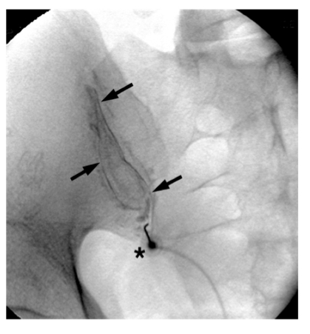
Positioning:
patient lies prone with the head turned to one side
The C-arm is rotated 25 to 35 degrees caudally from the axial plane to place the posterior-superior ilaic spine and the iliac crest cephalad along the line of the Si joint.
The C-arm is then rotated obliquely 0 to 30 degrees until the posterior-inferior aspect of the SI joint is clearly visible.
Two features of the SI joint are important to recognize:
1. the Si joint is curvilinear, often arcing somewhat laterally toward the anterior aspect, with confusing overlying shadows of the anterior and posterior portion of the joint
2.-is the overlying iliac crest that can block entry to the SI joint. To avoid placing a needle on the iliac crest rather than in the SI joint itself, use caudal angulation of the C-arm and limit the injection to the inferior aspect of the joint.

Slide 13
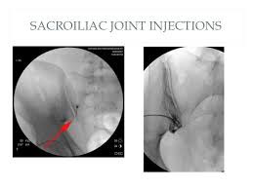
Block technique:
The skin and the subcutaneous tissue not the mussle are anethetized with 1-2 ml of 1% lidocaine.
A 22-gauge, 3.5 inch spinal needle is placed to remain coaxial or angeled in a slightly cephaled direction toward the inferior aspect of the joint and advanced toward the joint space using repeat anterior-posterior images. Once the surface of the joint space is contacted, the needle is advanced just slightly to penetrate the posterior joint capsule.
As the needle enters the joint space, the tip often curves slightly, following the contour of the surface of ilium.
The joint itself often holds only limited volume (typically<2ml), and placing contrast in the joint limits the ability to place local anesthetic and steroid (2ml) A total dose of 80mg of methylprednisolone acetate or equivalent can be administered or divided between both SI joints if bilateral injection is necessary. Using concentrated steroid (40 or 80mg per ml)allows 1:1 mixture with local anesthetic (0.5% bupivacaine) to provide immediate pain relief.
The most likely adverse effect is an exacerbation of pain in the days following resolution of the local anesthetic effect. Ususally is mild and self limited.

Slide 14
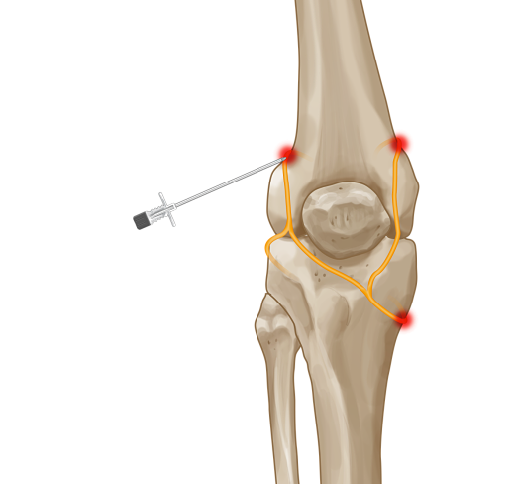
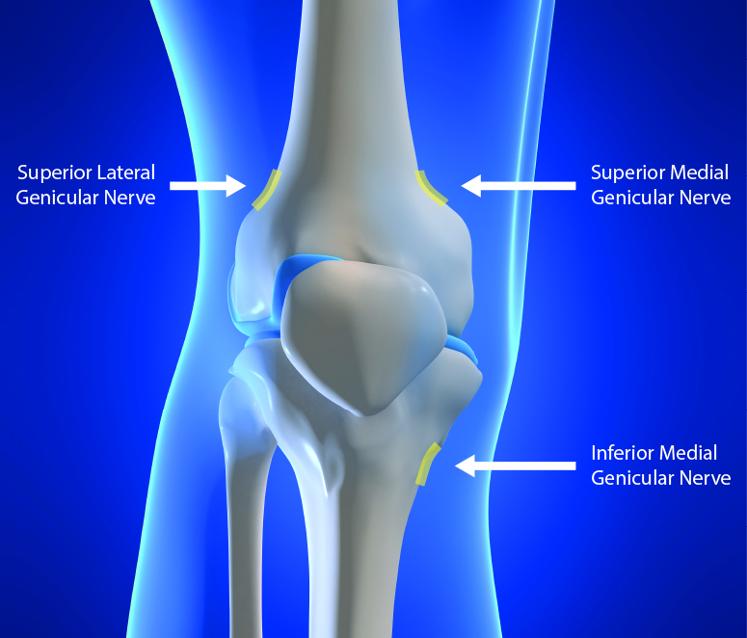
Genicular Nerve block – knee joint injection
Anatomy:
The knee joint is innervated by the articular branches of various nerve, including the femoral, common peroneal, saphenous, tibial, and obturator nerves. These branches around the knee joint are known as genicular nerves. The targets included the superior lateral(SL), superior medial (SM) and inferior medial (IM) genicular nerves which pass periosteal areas connecting the shaft of the femur to bilateral epicondyles and shaft the tibia to the medial epicondyle.This procedure is based on the teory that cutting the nerve supply to a painful structure may alleviate pain and restore function.
Patient selection :
Patient with chronic kneee pain secondary to osteoartritis, meniscal tears
Patient with failed knee replacement
Patient unfit for knee replacement
Patient who want to avoid surgery

Slide 15
Block technique:
These injections are performed under fluroscopy guidance with the patient in supine positionj with the knee is in the 90 degree flexion. A small amount of local anaesthetic (~2-3ml) of bupivacaine or ropivacaine is injected around the superior lateral (SL), superior medial (SM) and the inferior medial (IM) branches.
A response is considered positive if there is at least 50% reduction in pain in the 24hrs following injection.
Complications are rare, particularly if injection are performed using a precise needle-positioning technique. Septic arthritis can be avoided with appropriate aseptic precautions.
Next step is radiofrequency ablation of genicular nerves

