Slide 1
Prof. dr Danko Živković
University of Montenegro
Durres/ 22-23 October 2019

Slide 4
Why HEPMP project?
Pain is probably one of the oldest and most universal forms of stress and one of the earliest sufferings of humankind.
Pain is the follower of many diseases and conditions: Rheumatoid arthritis, postherpetic neuralgia, degenerative spine conditions, osteoarthritis, AIDS, migraine,diabetic neuropathy, and phantom pain are examples of chronic pain as well as cancer.
In the economic sphere, it is estimated that the cost to treat patients with chronic pains exceeds the total cost to treat patients with heart disease, cancer, and AIDS.
Prolonged pain is among the major causes of absence from work, sick leaves, disability retirement, severance pay, and low productivity. It is a problem of public health for its prevalence, high cost, and negative impact on the quality of life of patients and their families.

Slide 5
Why HEPMP project?
Despite the efforts and the fact that it is as old as humanity itself, pain neither has been completely understood nor can be totally controlled.
Low awareness of the importance of treating pain lies amongst the public and health care professionals.
Number of doctors trained for pain medicine is insufficient.
We need to improve knowledge about pain and raise awareness, both professionals – healthcare workers, and society, about the significance of this problem.

Slide 7
HEPMP aims
Strengthening Capacities for Higher Education of Pain Medicine in Western Balkan Countries
Development of Pain medicine service provision in the country by providing qualified trained staff.
Support will be granted to operationalize the recently established educational program in the form of pain medicine specialization and the possibility of the develop- ment of undergraduate education programs.
Establish an academic network and improve professional cooperation through opportunities provided by new technologies (Internet, telemedicine, etc.)

Slide 8
Tasks of the project
Tasks of the Universities of European Union countries
Assist in the analysis of the current situation in this area in Western Balkan Countries.
Defining the possible changes that would improve or introducing curriculum of pain medicine in the undergraduate and postgraduate education.
Training of trainers from Western Balkan Countries in the European Union countries.

Slide 9
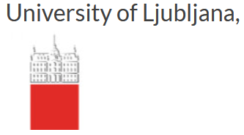
EU Partner Institutions

Slide 10
Tasks of Universities of Partner countries
To modernize the existing curriculum of pain medicine specialization. Coordinate the existing postgraduate education curriculum in the field of pain medicine with European Pain Federation (EFIC) curriculum.
To develop a module lectures for undergraduate studies of pain medicine.
To develop a web platform for mutual learning and communication for health care professionals who deal with pain medicine.
To organize courses of pain medicine for doctors in primary health care.
Develop written material for Life Long Learning -LLL (books, brochures, scripts, leaf- lets, digital material etc).
Establish an academic network of health care professionals and universities in the field of pain medicine.

Slide 11
Universities of Partner countries

Slide 12
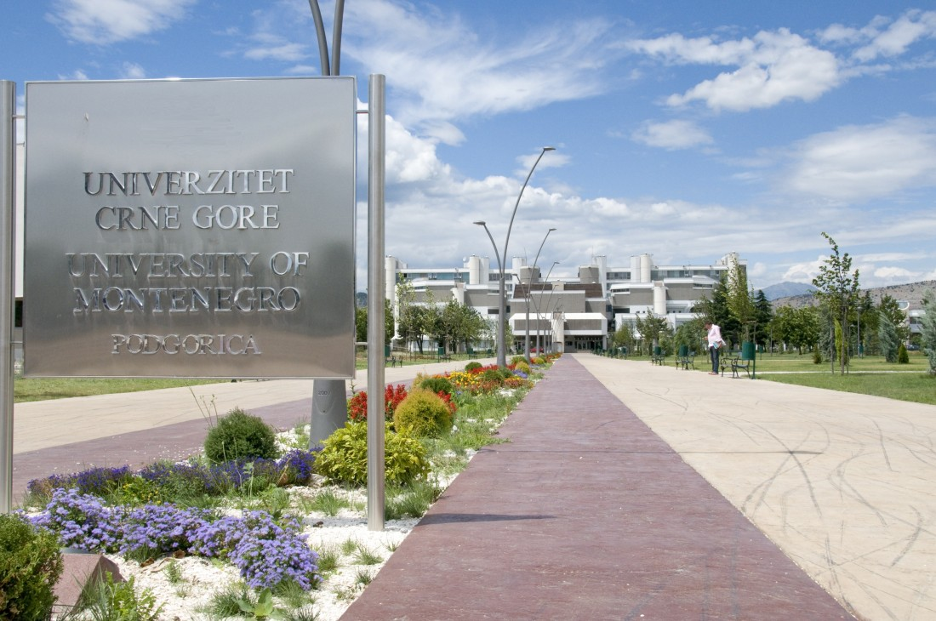
University of Montenegro

Slide 14
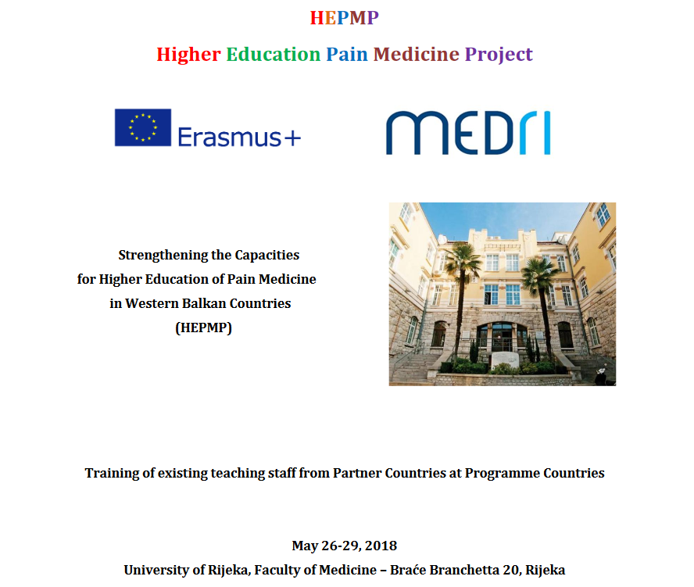

Slide 19
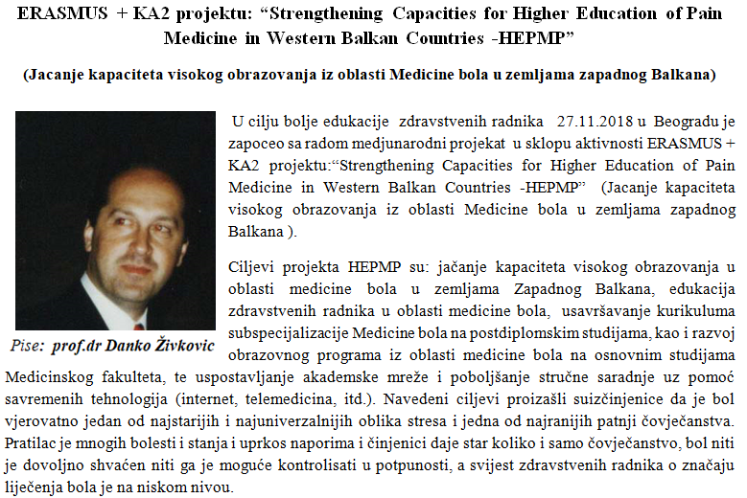

Slide 20
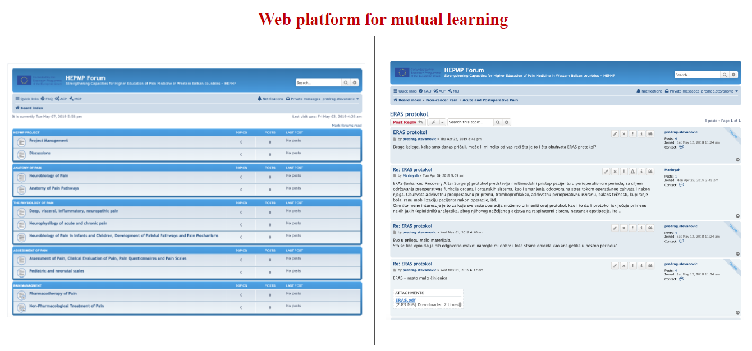

Slide 23
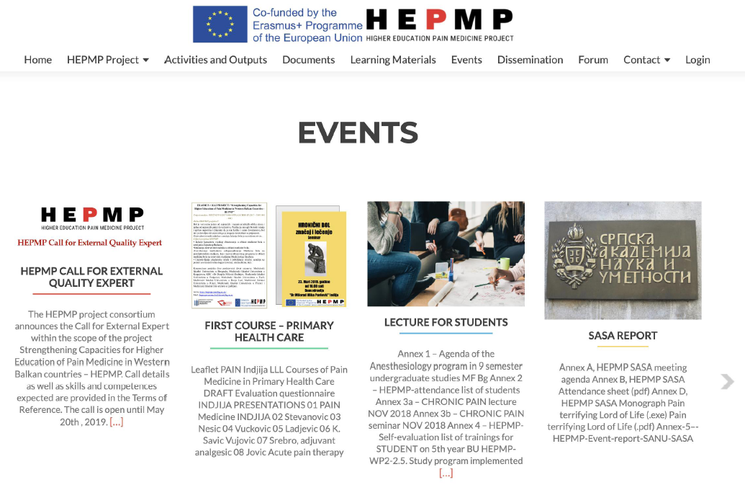

Slide 25
Thank you for attention!!!

